Slide 1

Notes:
Hi team! Happy winning☺
As earlier established, In line with our ambition to keep the acquisition funnel for Peak baby growing, this item is heavily laced with clinical studies to substantiate our claims
We want to strengthen our brand salience beyond DHA(brain development). HBG principles supports the fact that the more CEPs/reco drivers are associated with your brands, the higher your chances of being considered/bought/recommended.
Thus we want to create more associations with other CEPs and reco drivers to keep the acquisition funnel growing.

Slide 2
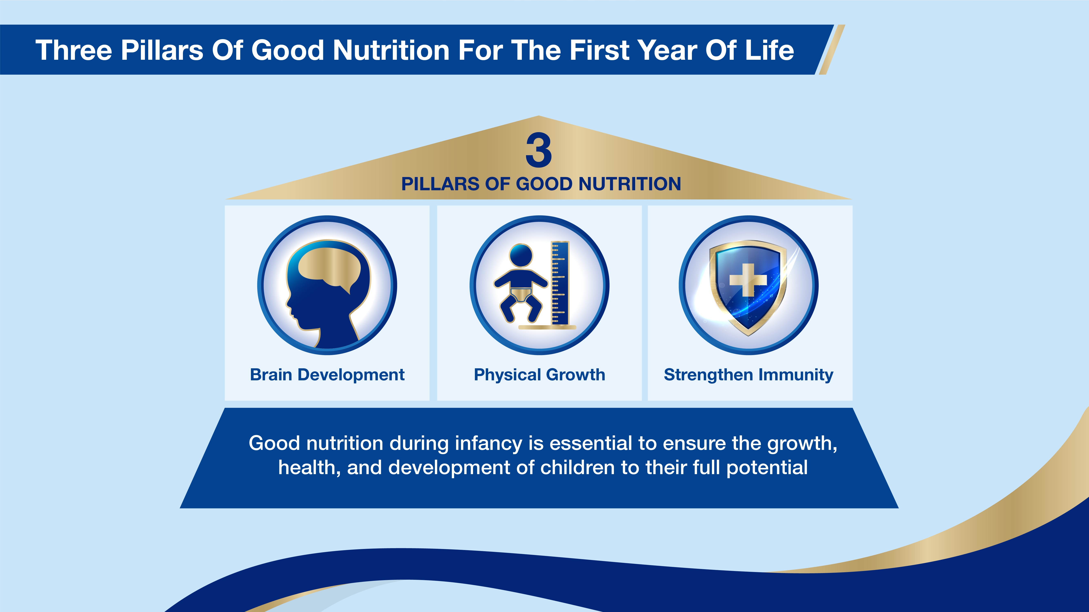
Notes:
Brain development, Physical growth and Immunity are 3 critical pillars of child nutrition important to both the HCPs and mums. Important to stress this fact to the HCPs as they are major reco drivers

Slide 3

Notes:
Breastmilk is incontrovertibly an excellent source of nutrition for the growing infant

Slide 4
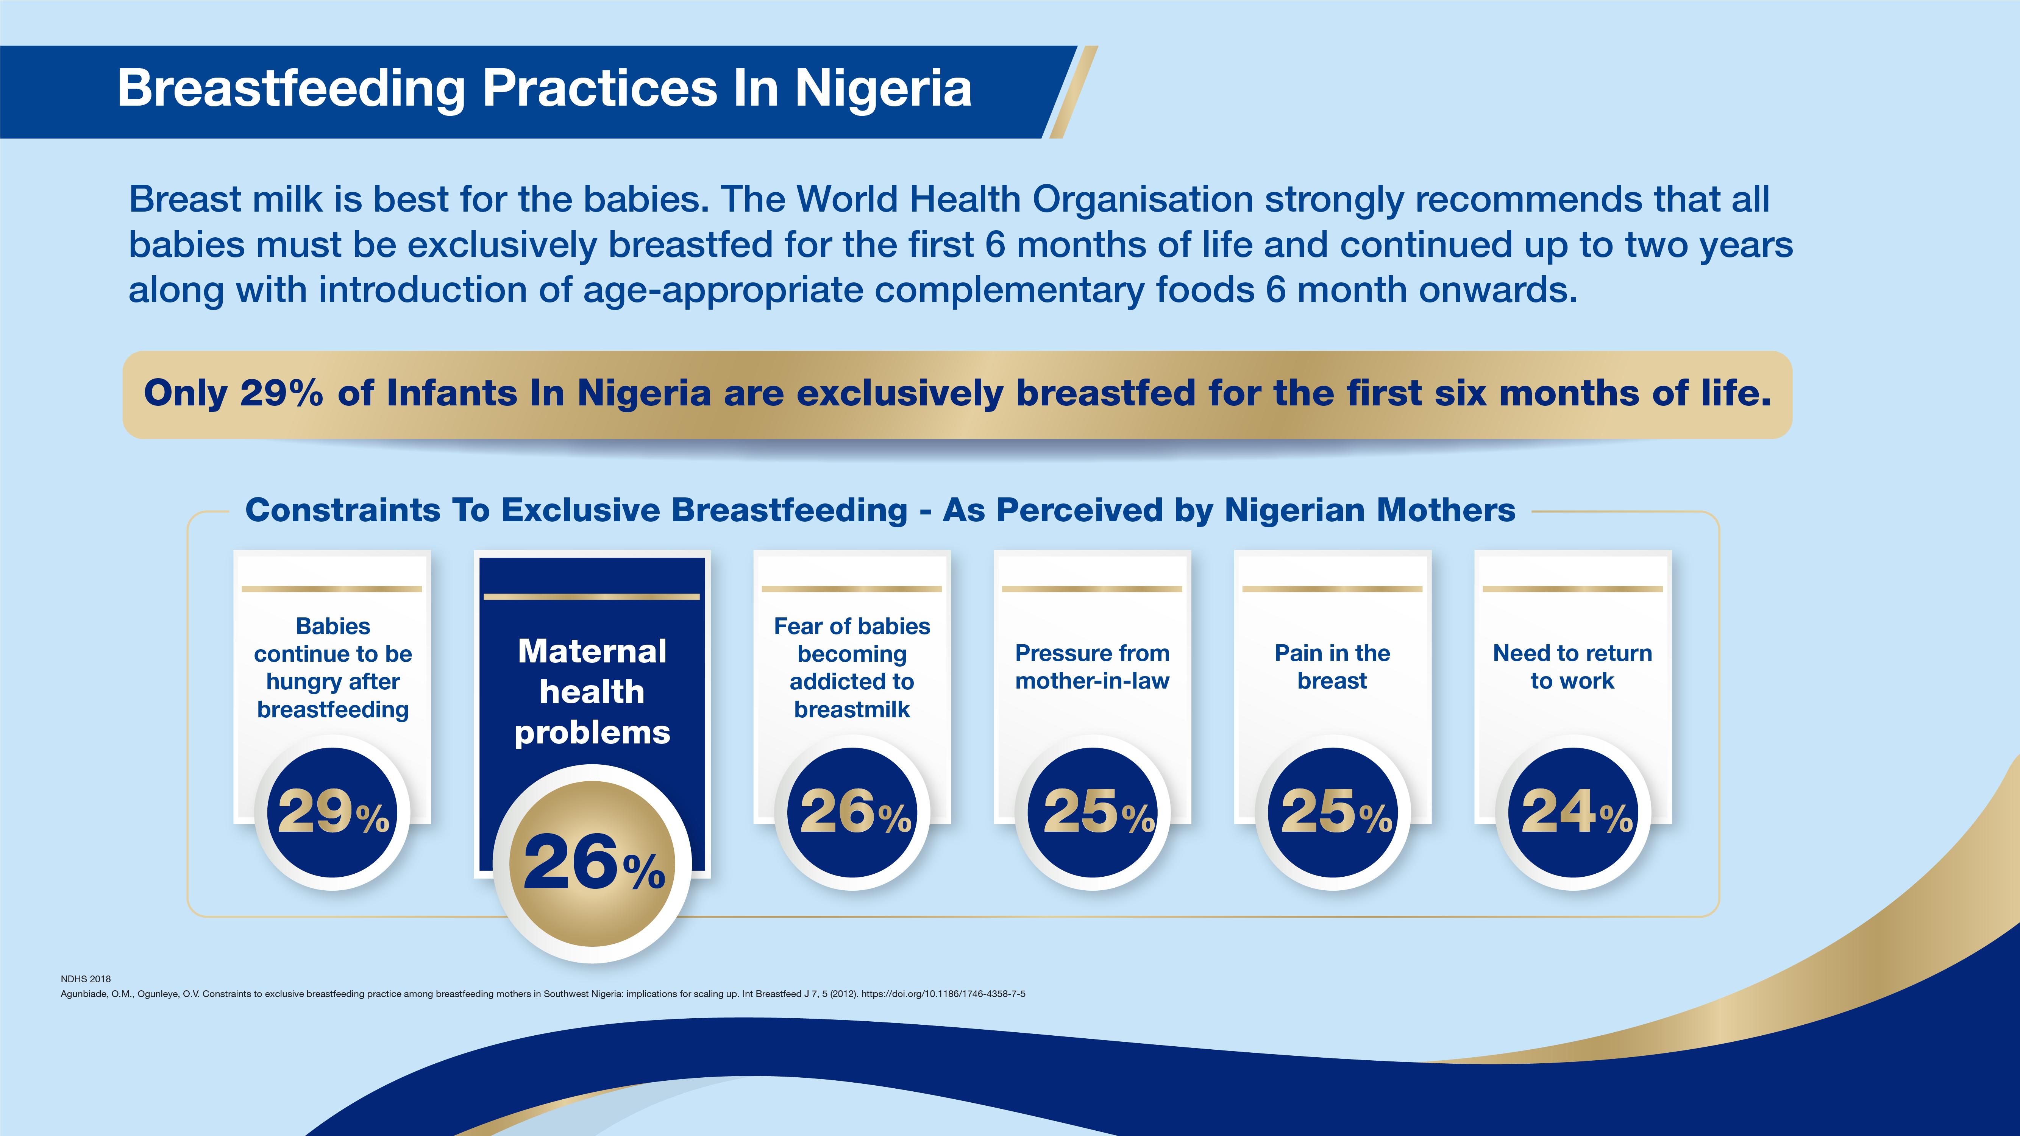
Notes:
Having established the benefits of breastmilk and WHO recommendation, how EBF compliant are Nigerian mums? “Maternal health problems” are considered the most valid reason why a mum might not be able to breastfeed.

Slide 5
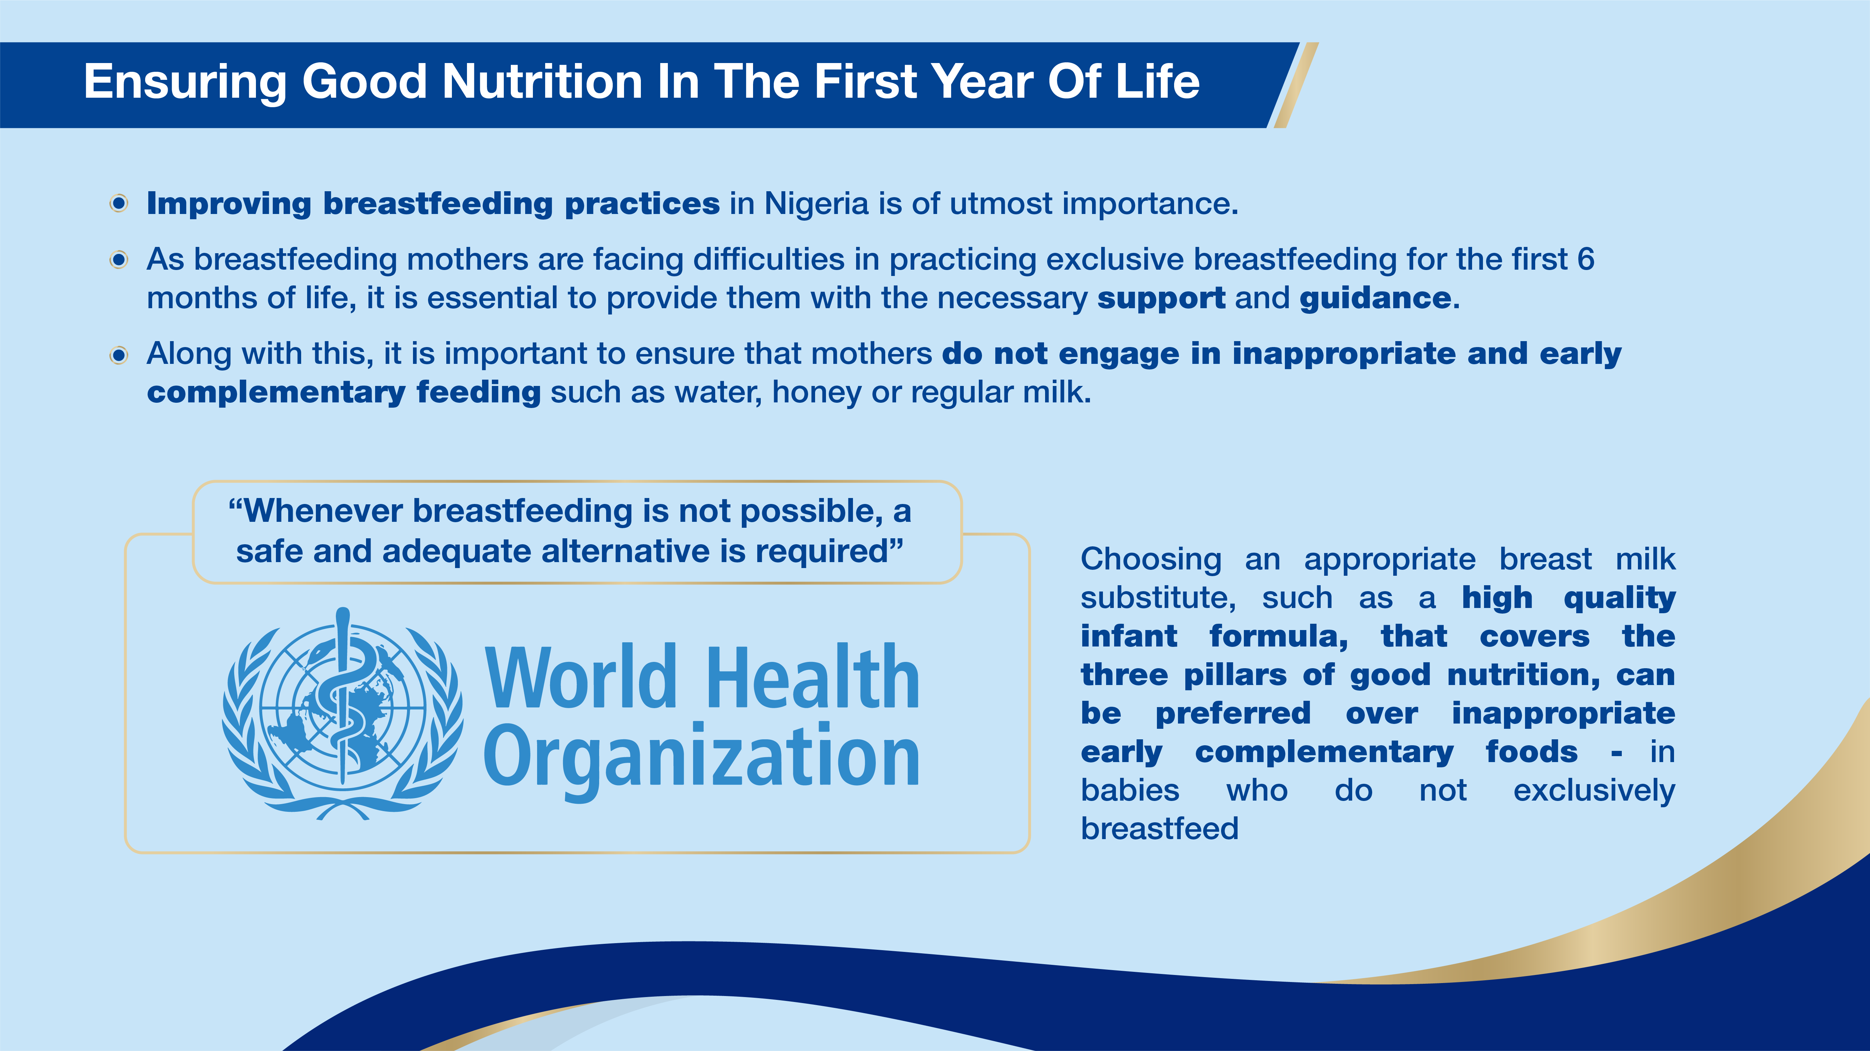
Notes:
Improving breastfeeding practices in Nigeria is of utmost importance as we seek to achieve the desired outcomes along the 3 key pillars of brain development, physical growth and immunity

Slide 6
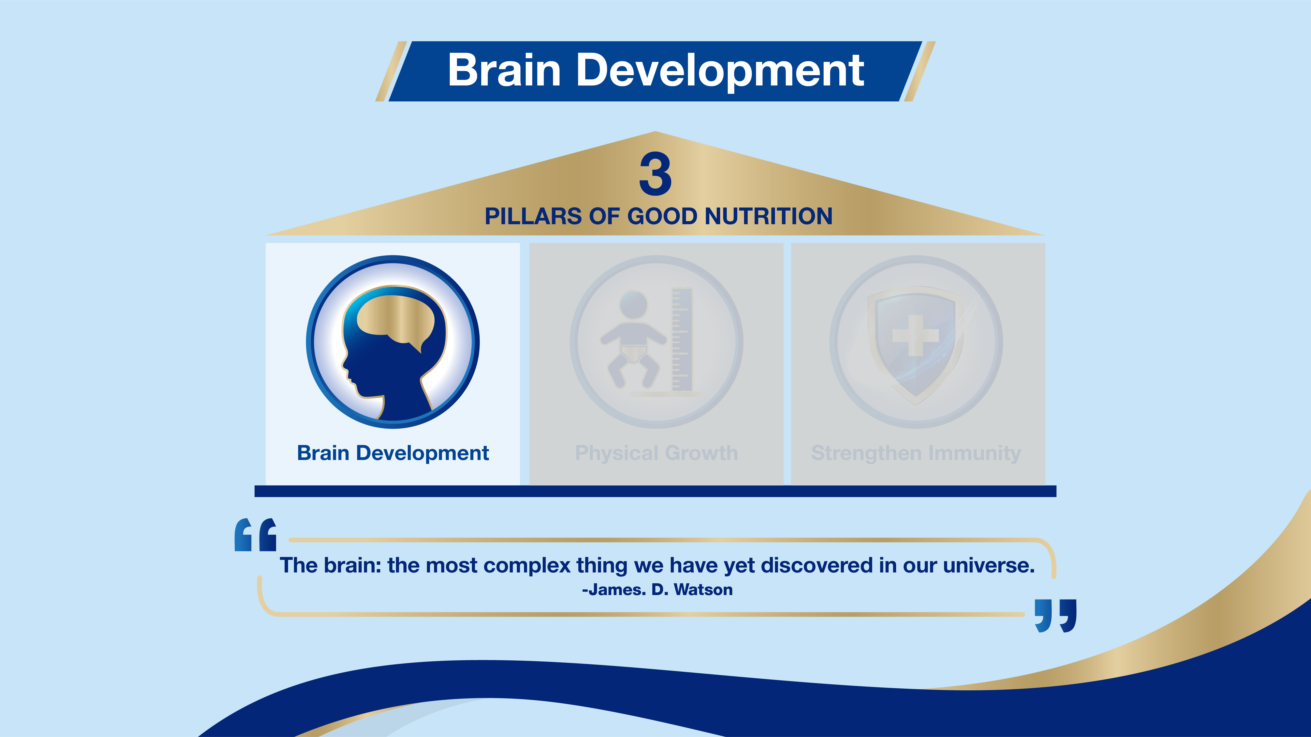

Slide 7
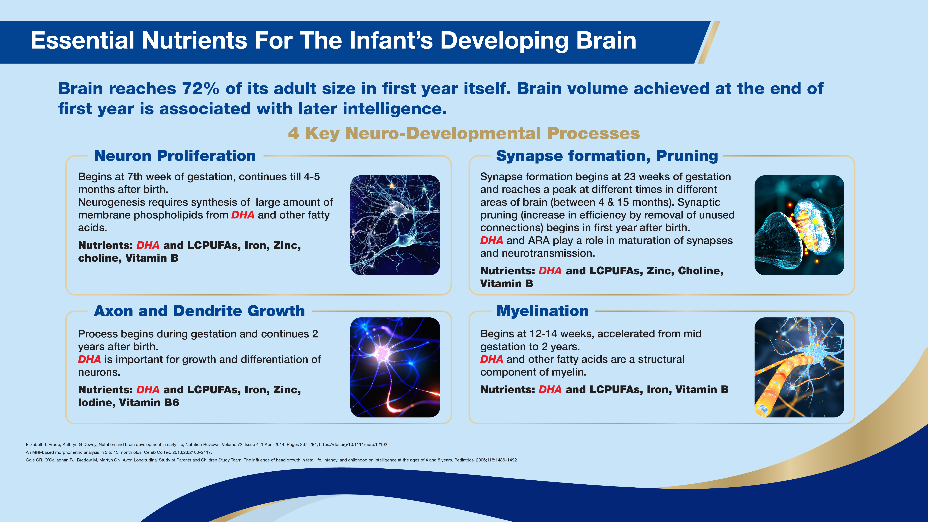
Notes:
The brain of a child is a developing miracle. A truly complex process that requires good nutritional support particularly in the early years. The brain reaches 72% of its adult size in the first year. There is scientific evidence that Brain volume achieved at the end of the first year is a strong determinant of later life intelligence. During pregnancy and infancy, the brain volume achieved is essential to establish the neuronal networks and capacity for the development of cognitive, motor, social, and emotional skills that will be continually refined throughout childhood and adulthood. Such dramatic changes in brain structure and function are associated with very large energetic demands exceeding by far those of other organs of the body.
Cognitive development is also at its Peak within the first one year of life.

Slide 8
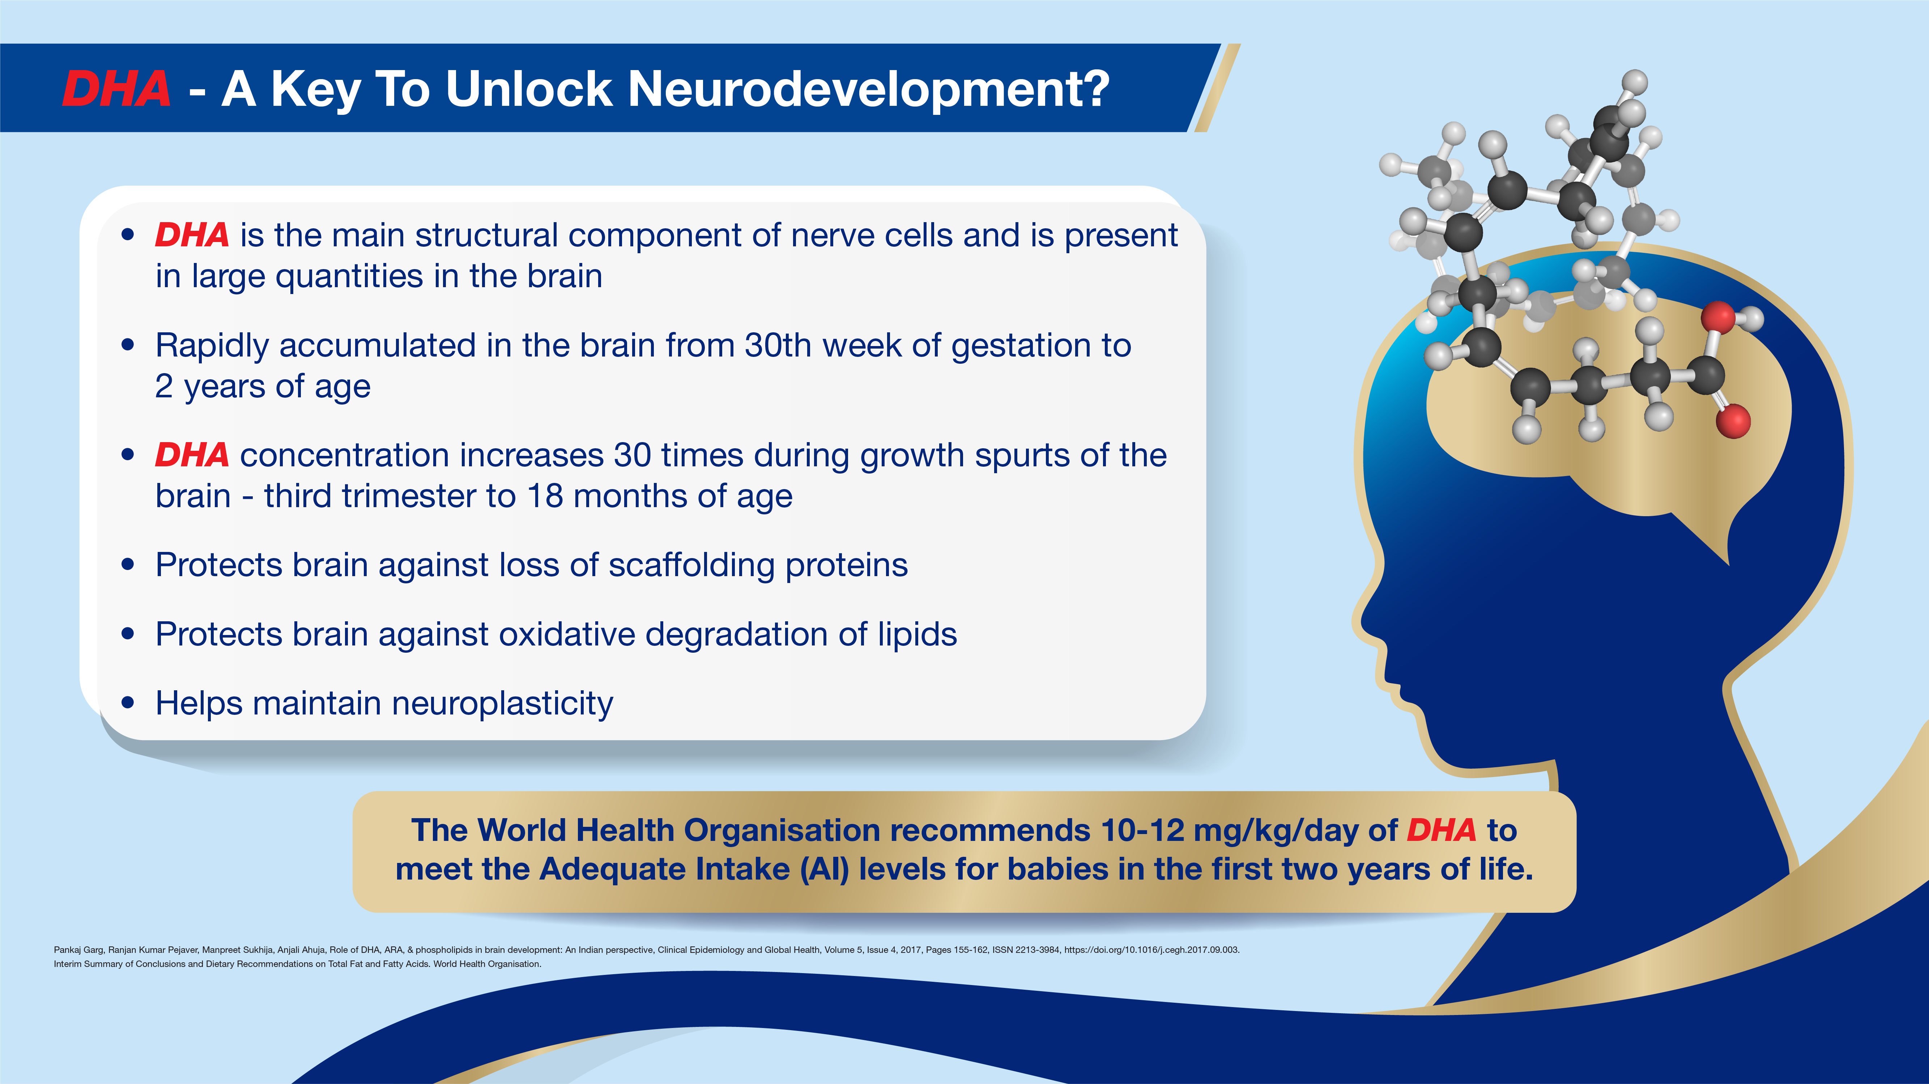
Notes:
Neuroplasticity, also known as neural plasticity, or brain plasticity, is the ability of neural networks in the brain to change through growth and reorganization.
The function of scaffolding proteins is to bring together two or more proteins in a relatively stable configuration, hence their name. These proteins are further organized into functional units to enhance signaling efficiency

Slide 9
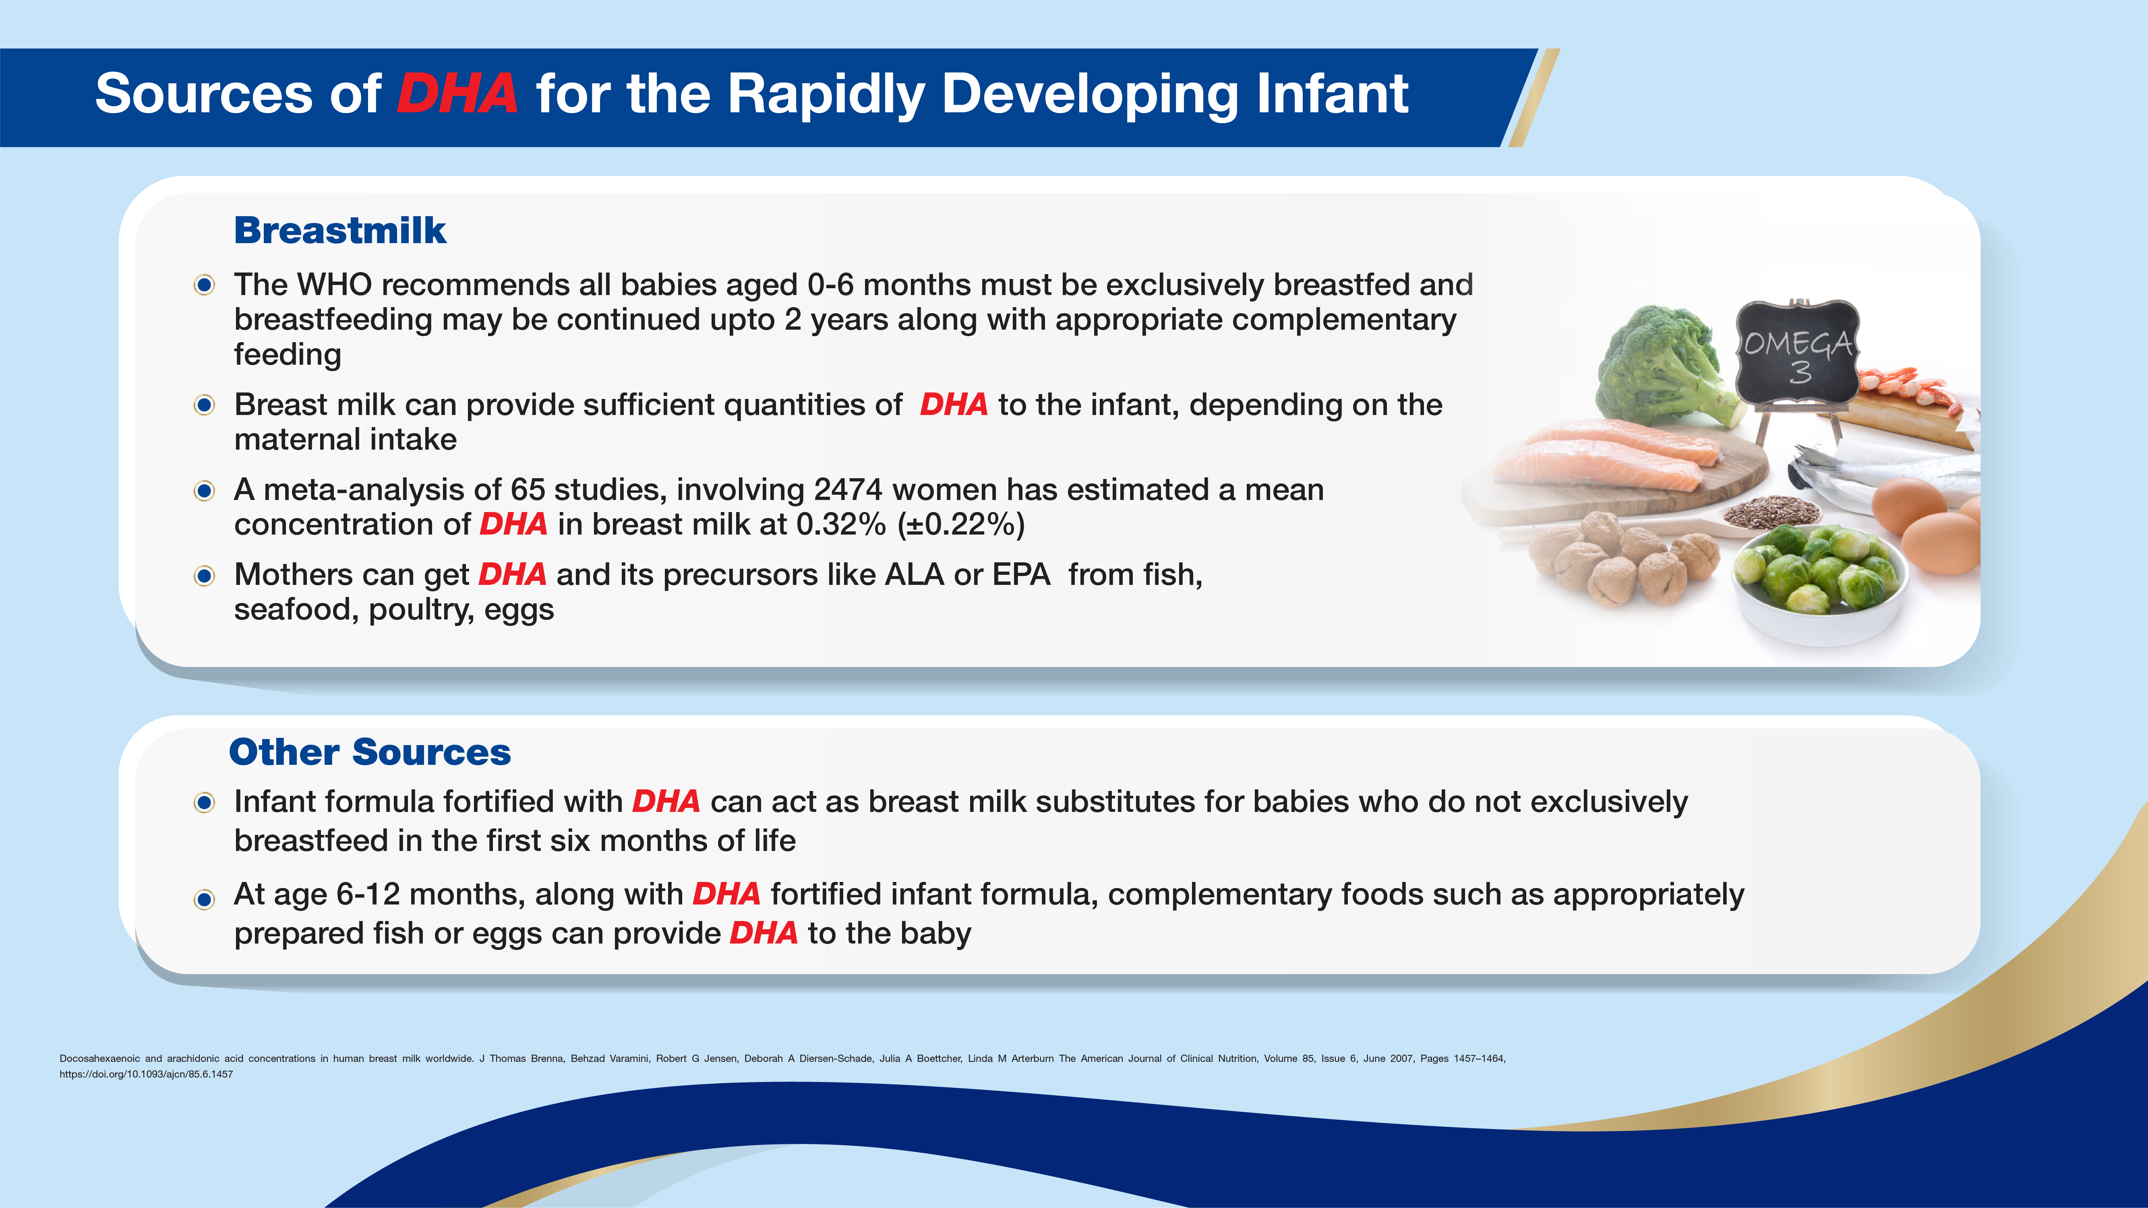
Notes:
The DHA content of breastmilk depends on the diet of the mother.

Slide 10
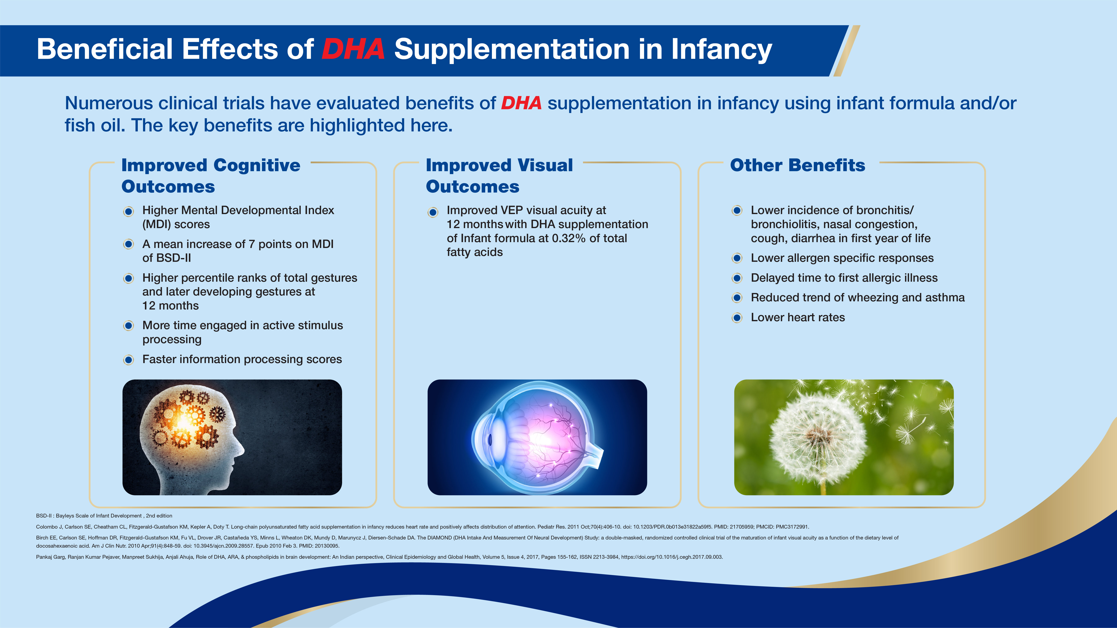
Notes:
BSID-II-Bayley Scales of Infant Development
VEP-Visual evoked potential (VEP) is a highly-advanced vision test that objectively measures how well your entire vision system is working.
Wheezing- refers to a high-pitched, coarse whistling sound made while breathing. Often caused by respiratory allergies or infections.
Bronchitis is an infection of the main airways of the lungs (bronchi), causing them to become irritated and inflamed.
Bronchiolitis is a common lower respiratory tract infection that affects babies and young children under 2 years old. Most cases are mild and clear up within 2 to 3 weeks without the need for treatment, although some children have severe symptoms and need hospital treatment.

Slide 11
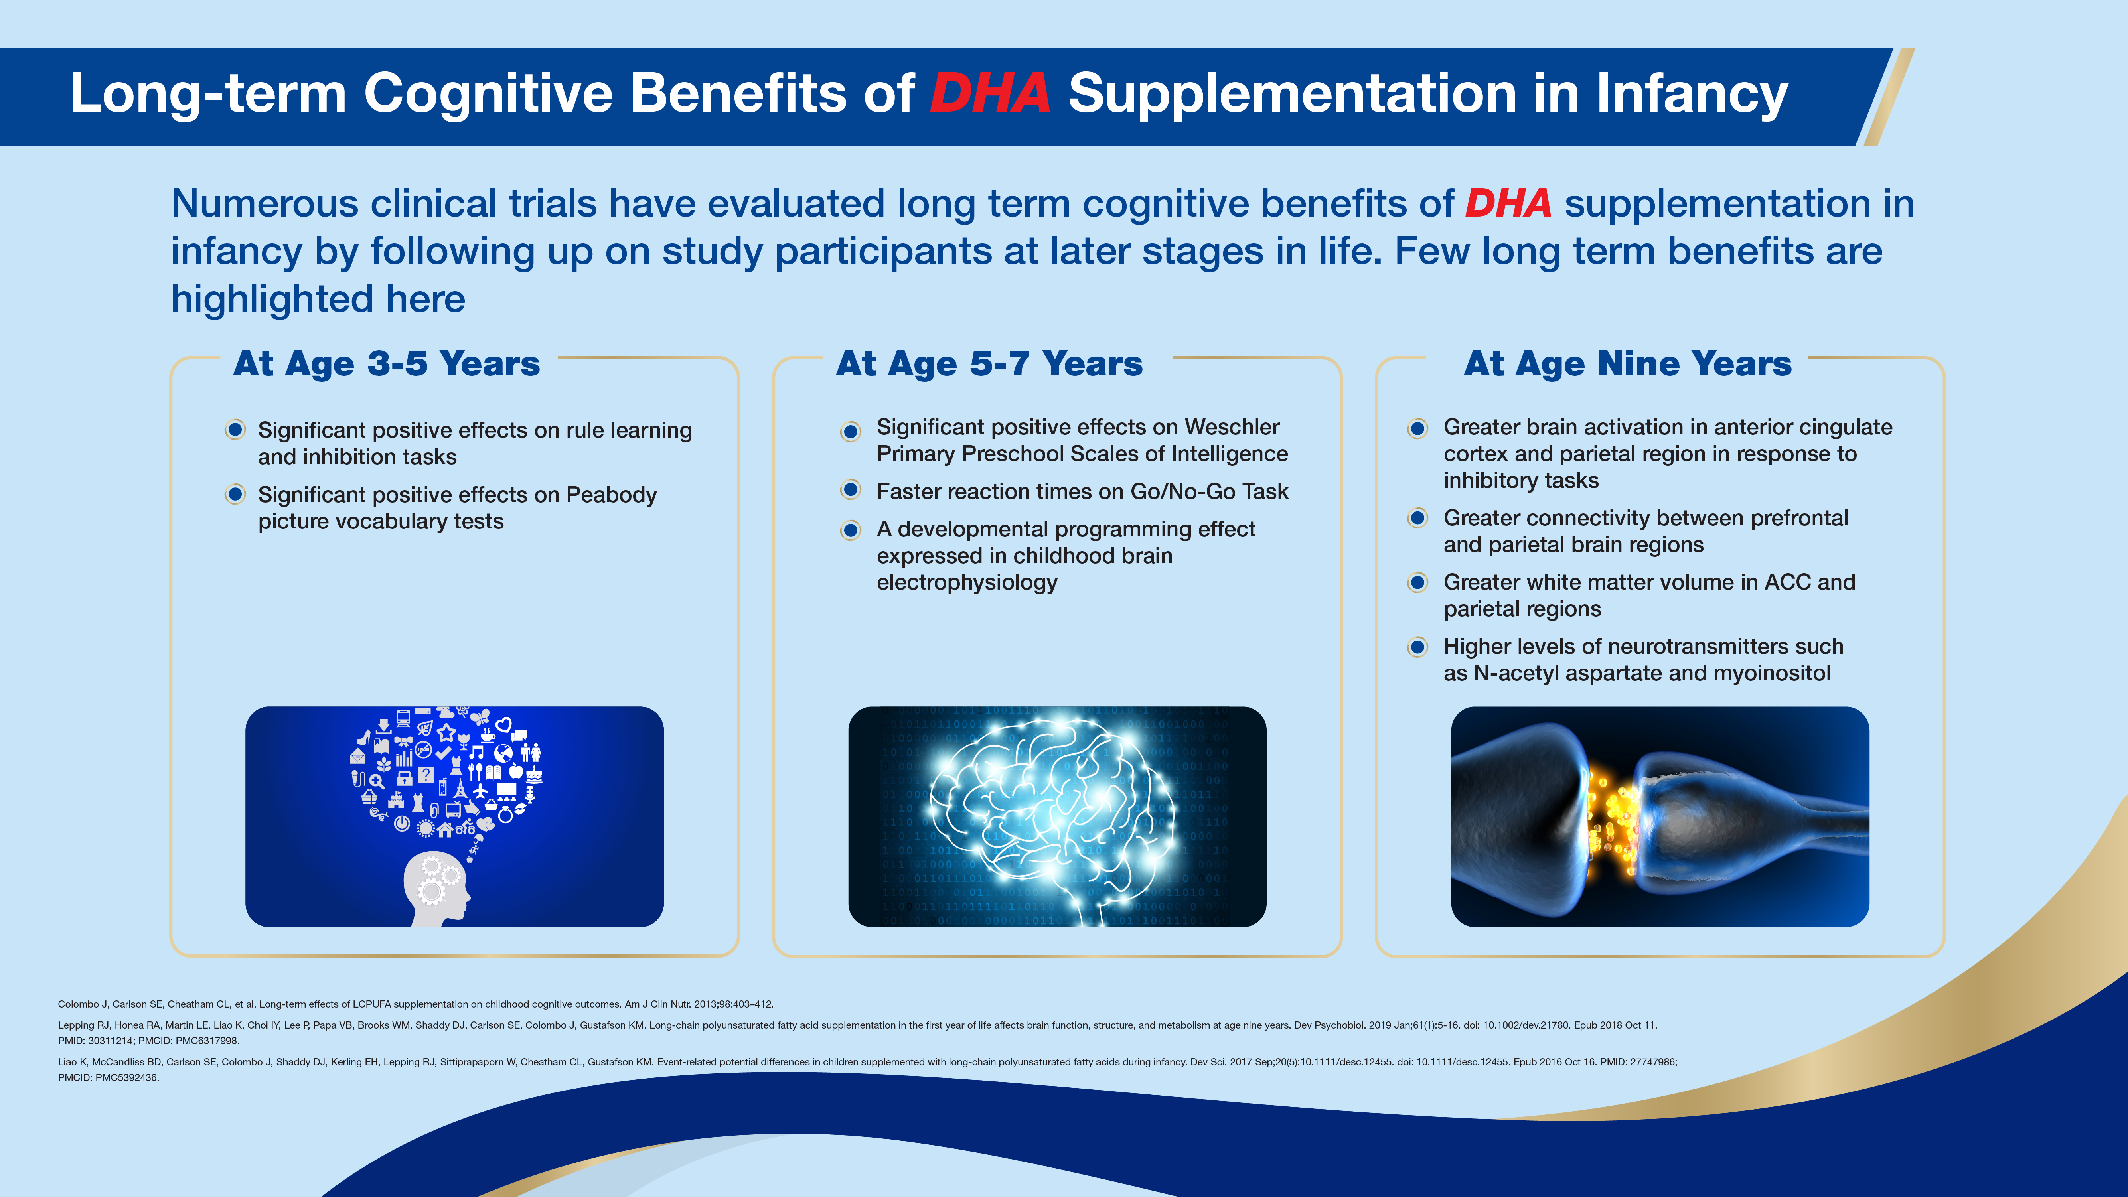
Notes:
The Peabody Picture Vocabulary Test (PPVT) is a test of listening comprehension for the spoken word in standard English; designed to measure children’s receptive (hearing) vocabulary and is considered to be a screening test for memory and cognitive function;
Brain Electrophysiology- a study of the electrical properties of biological cells and tissues in the brain (nervous system)
The Go/No-Go task is a computerized test used to assess inhibitory control, a cognitive process that enables humans to rapidly cancel motor activity even after its initiation. Each trial consists of one stimulus either indicating either "Go" (respond) or "No-Go". Thus, prepotent motor activity is elicited, which then sometimes has to be inhibited. The response accuracy of each No-Go trial is used as a measure for inhibitory control.
The Wechsler Preschool and Primary Scales of Intelligence (WPPSI), created by psychologist David Wechsler, is a scale designed to measure the intelligence of children ages 2 years and 6 months to 7 years and 7 months. The most current edition is the WPPSI-IV. This neuropsychological assessment provides clinicians subtest scores of intelligence, such as verbal skills, and a composite score of overall, general intelligence in children.

Slide 12
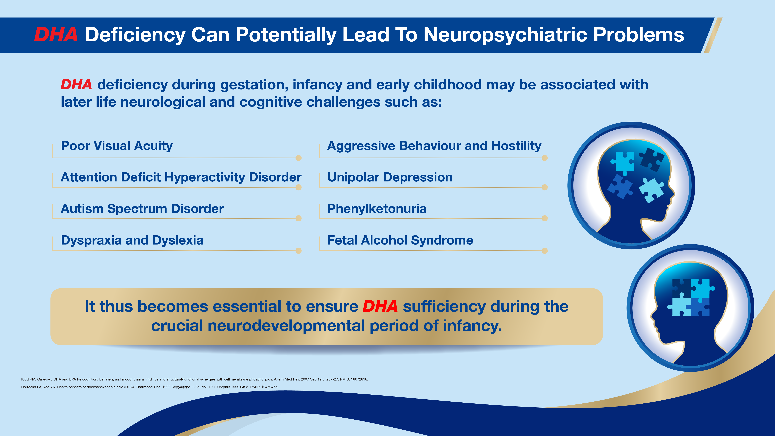
Notes:
Autism Spectrum Disorder (ASD): a complex developmental condition that involves persistent challenges in social interaction, speech and nonverbal communication, and restricted/repetitive behaviours.
Dyslexia- a learning difficulty to read write and spell.
Dyspraxia- a term used to describe a difficulty in motor coordination skills.
Fetal Alcohol Syndrome (FAS) - a condition that can occur in a person whose mother drank alcohol during pregnancy. Persons with FAS have difficulty with attention, poor memory, difficulty in school (especially with math), learning disabilities, speech and language delays, intellectual disability or low IQ and Poor reasoning and judgment skills.
Phenylketonuria (PKU)- an inborn error of metabolism that results in decreased metabolism of the amino acid phenylalanine. Accumulation of phenylalanine in the body can lead to brain damage, intellectual disabilities, behavioral symptoms or seizures.
Unipolar depression is a very serious and common mood disorder. Individuals that are affected by this form of depression experience continuous feelings of sadness, or lack of interest in interacting with the world around them.

Slide 13
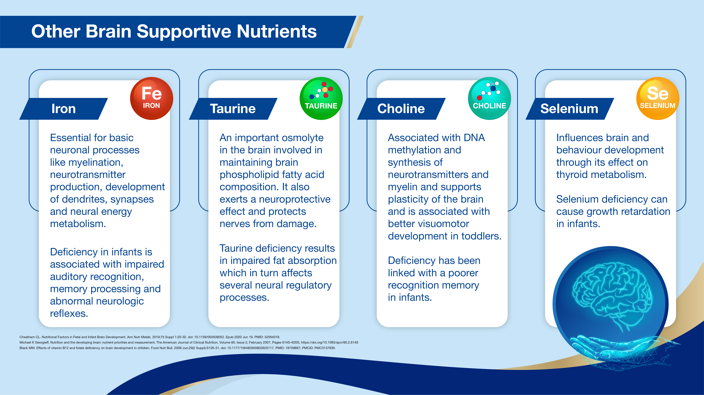
Notes:
DHA works in synergy with other brain-supportive nutrients like Iron, Taurine, Choline and Selenium to support overall brain development

Slide 14
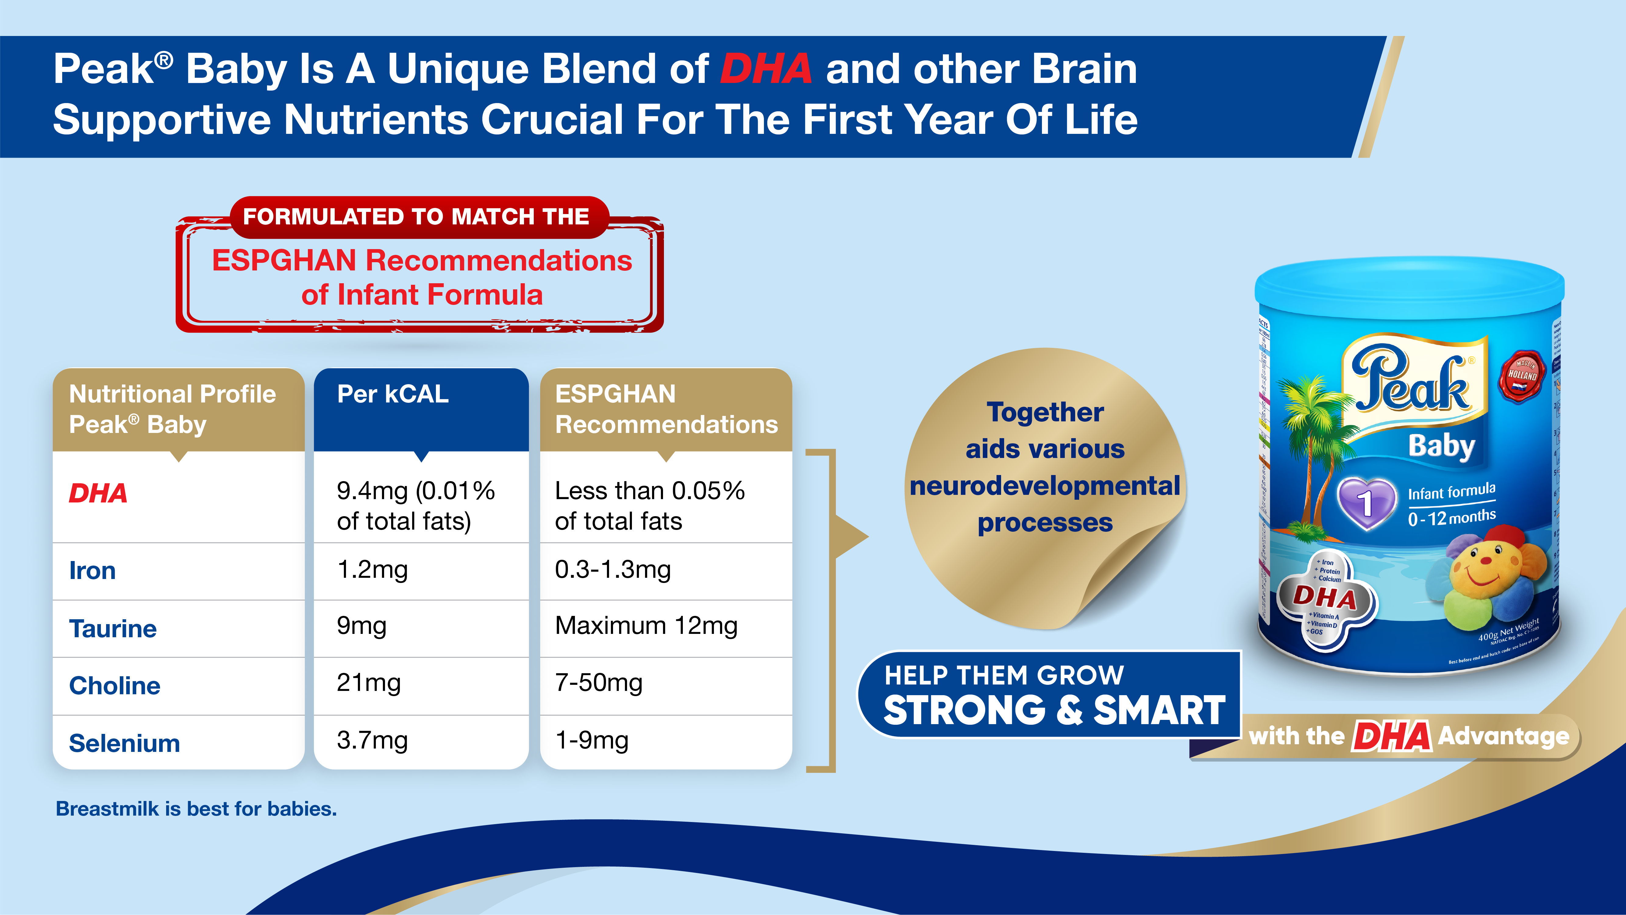
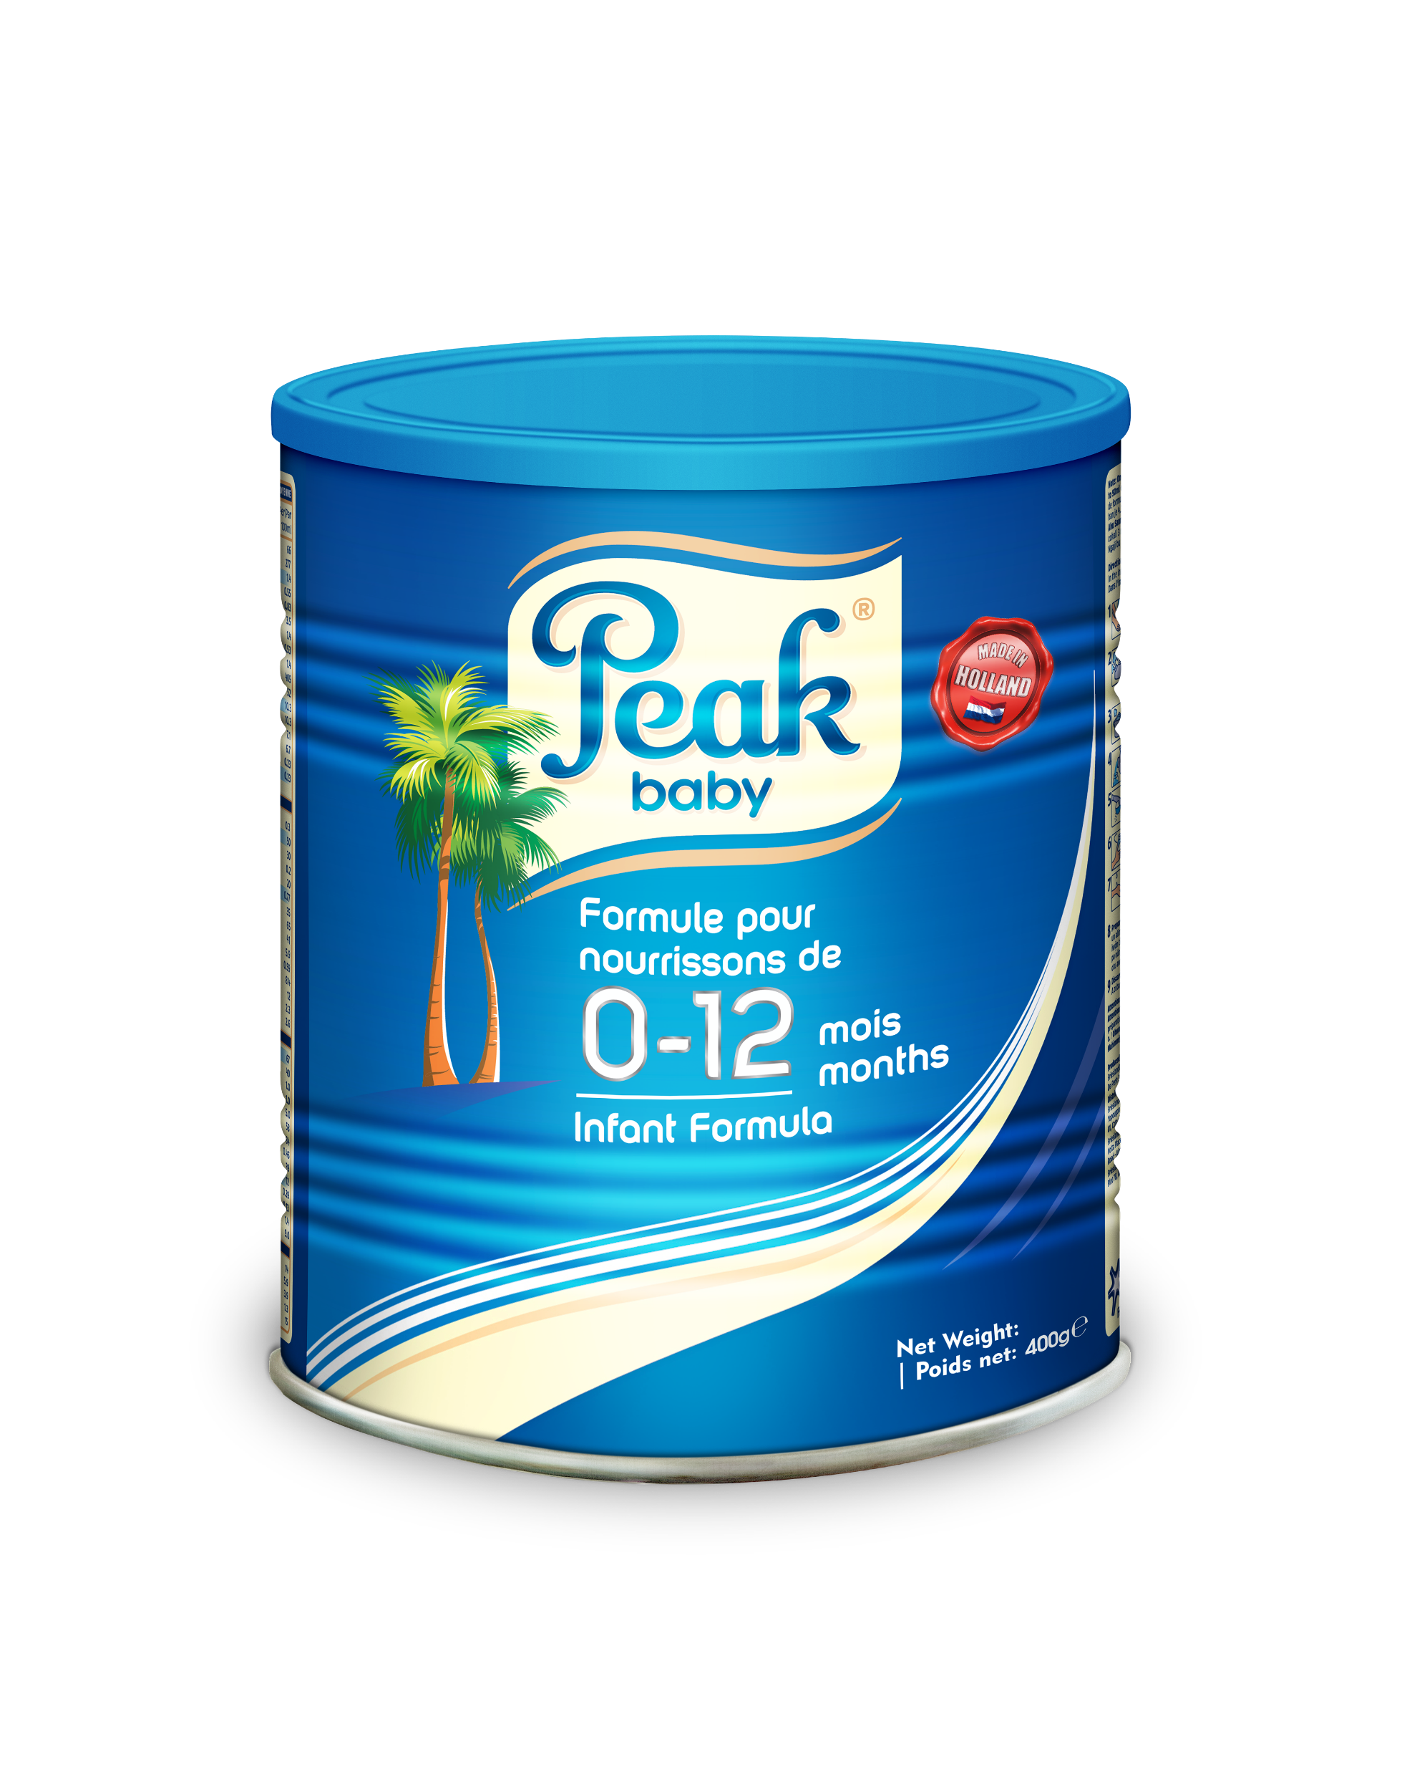
Notes:
Always stress on the call to action: Help them grow strong and smart with the DHA advantage

Slide 15
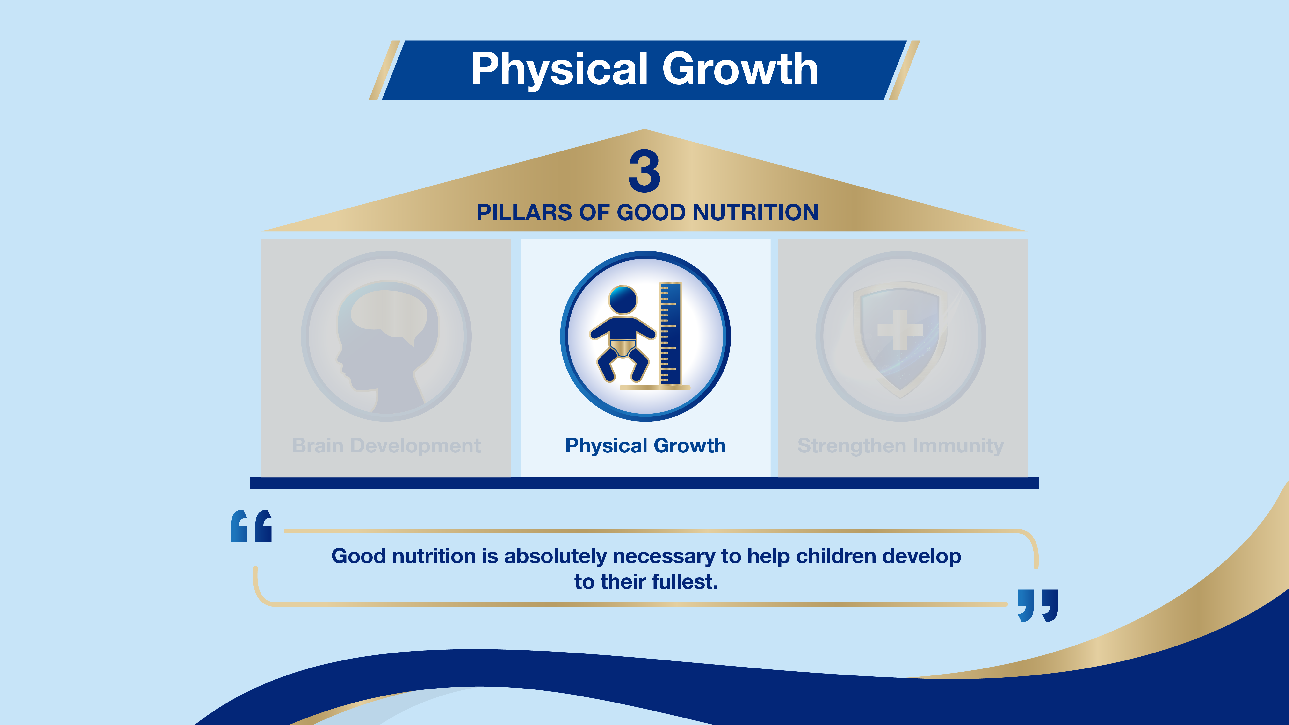

Slide 16
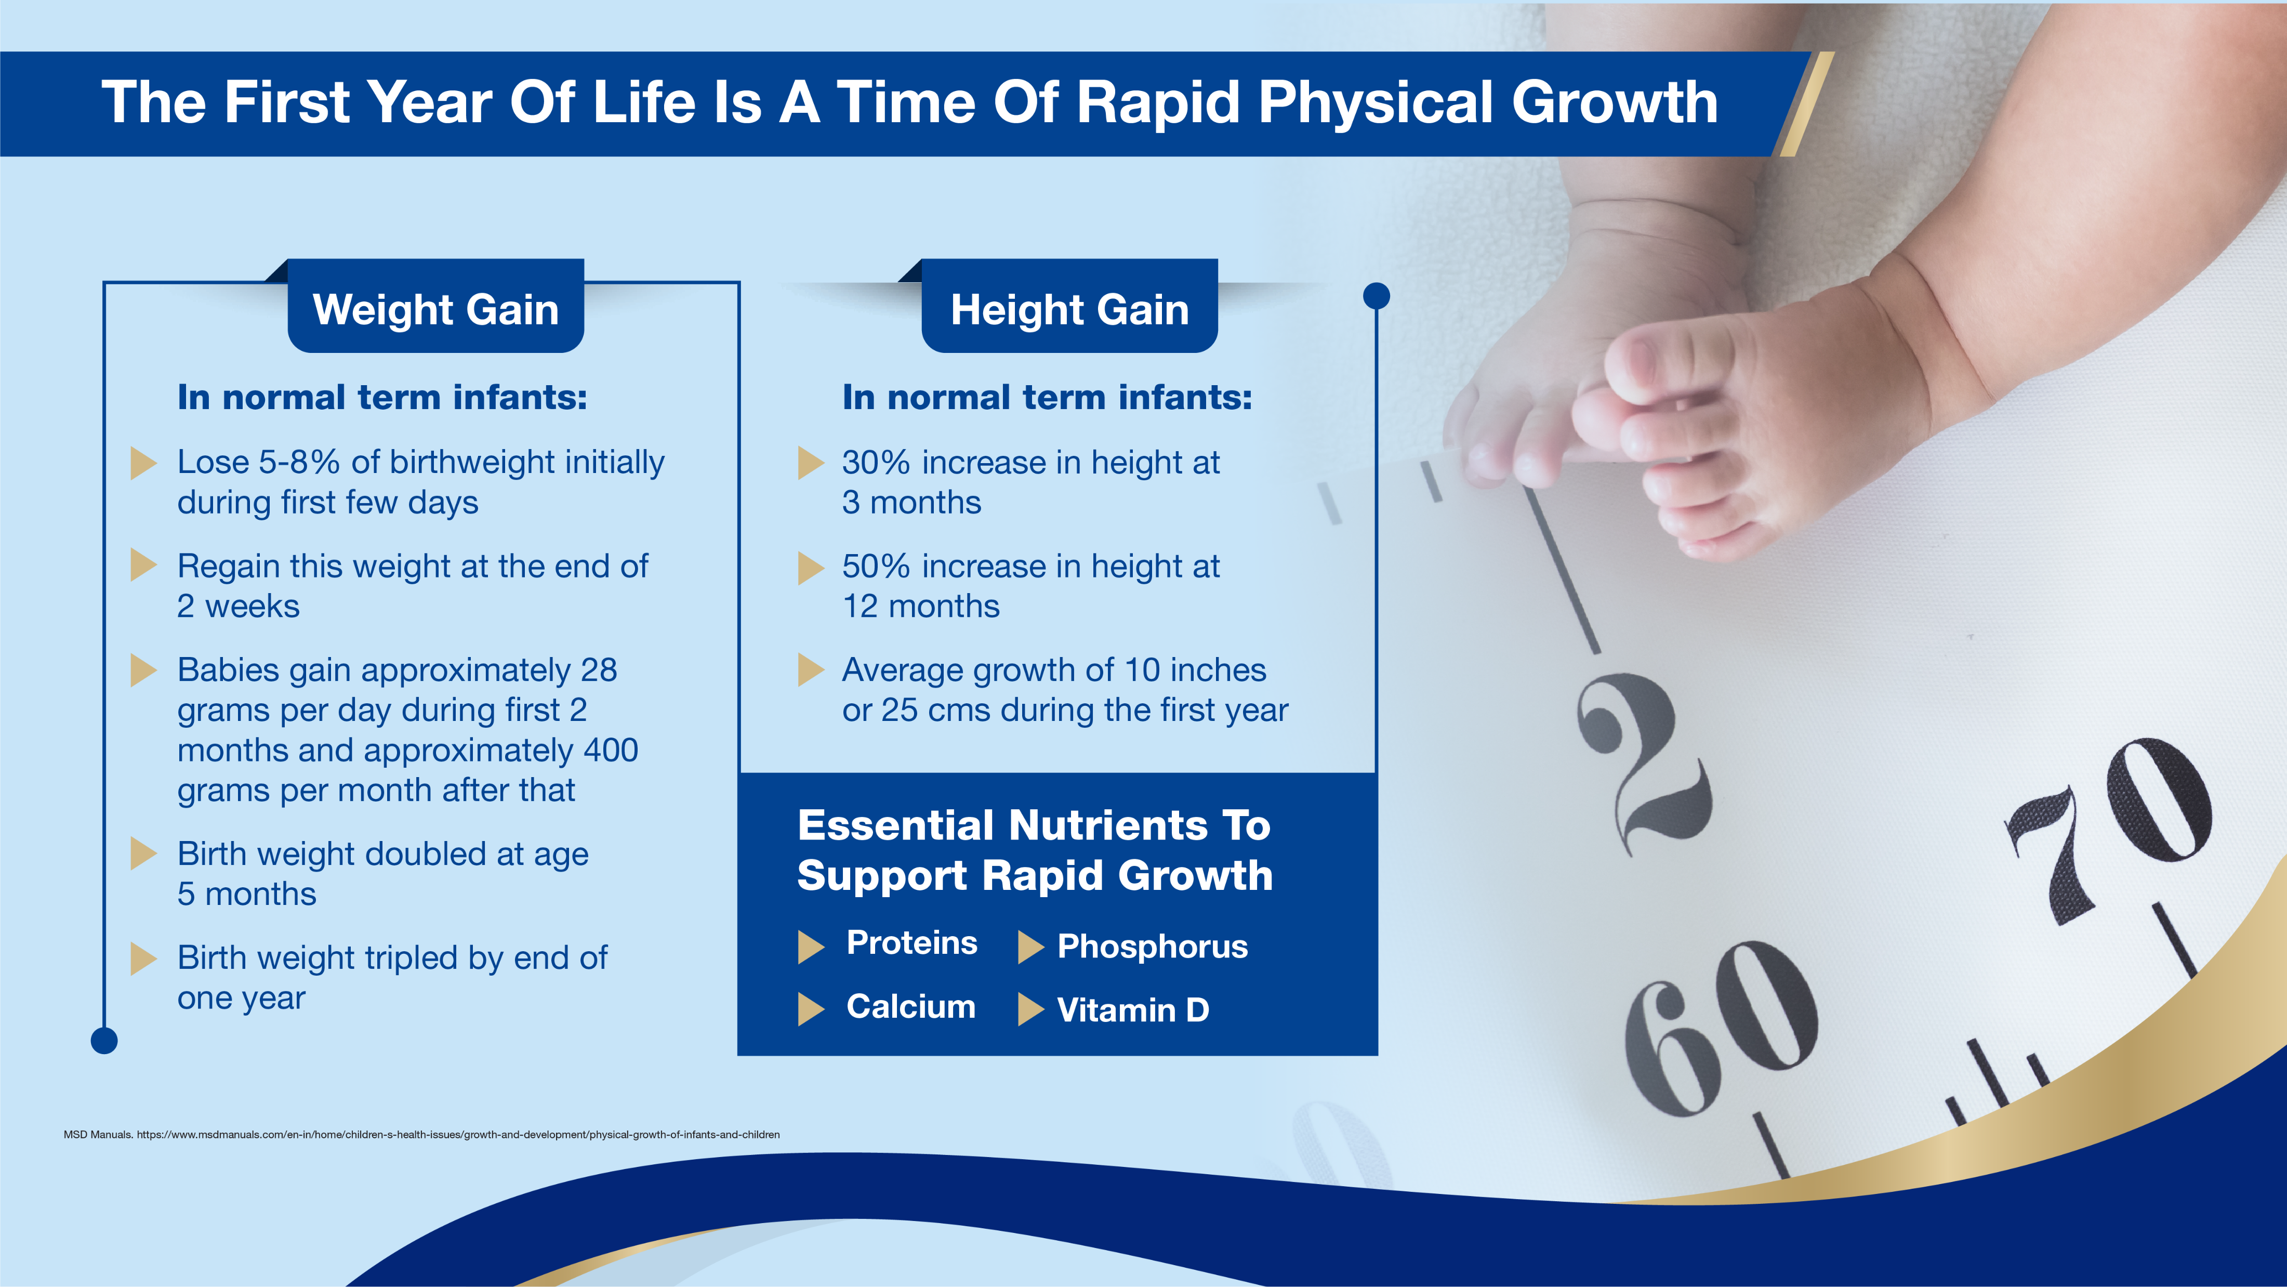
Notes:
During infancy, growth rate is faster compared to other life stages. Birth weight triples and length increases by 50% by the end of the first year

Slide 17
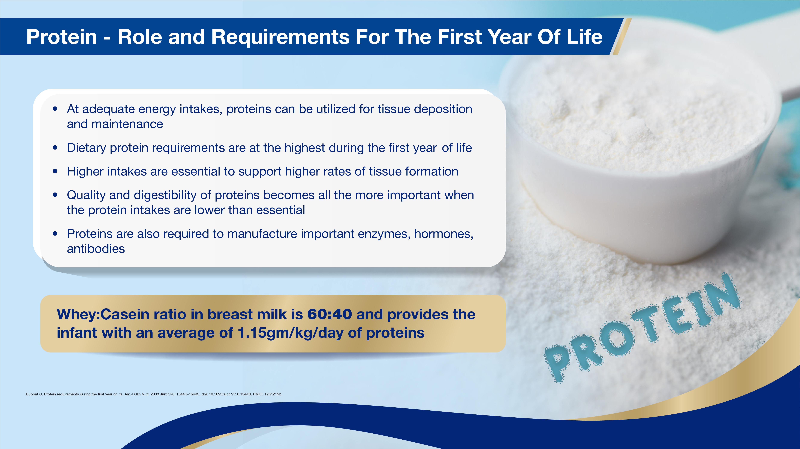
Notes:
Proteins are large, complex molecules that play many critical roles in the body. They do most of the work in cells and are required for the structure, function, and regulation of the body's tissues and organs.

Slide 18
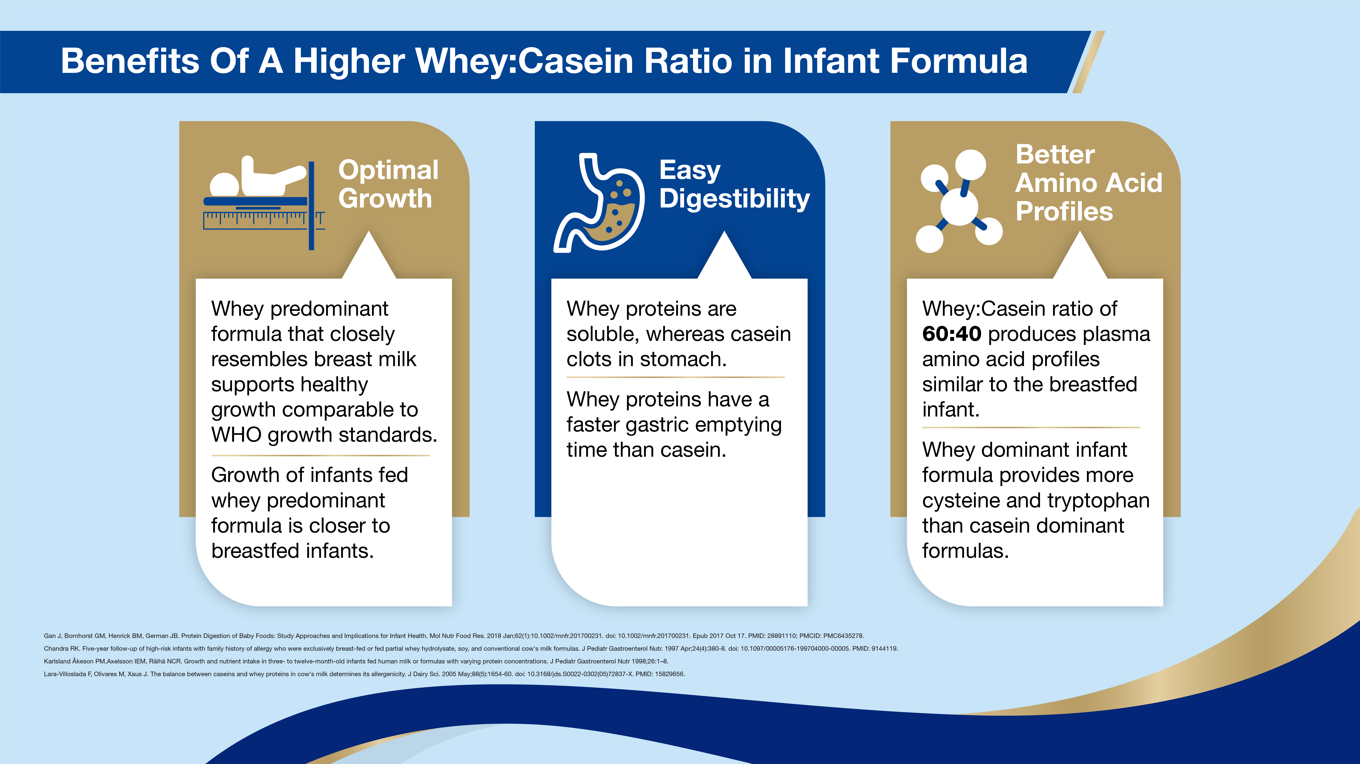
Notes:
Similar to breastmilk composition, a higher whey:casein ratio is desirable in infant formula

Slide 19
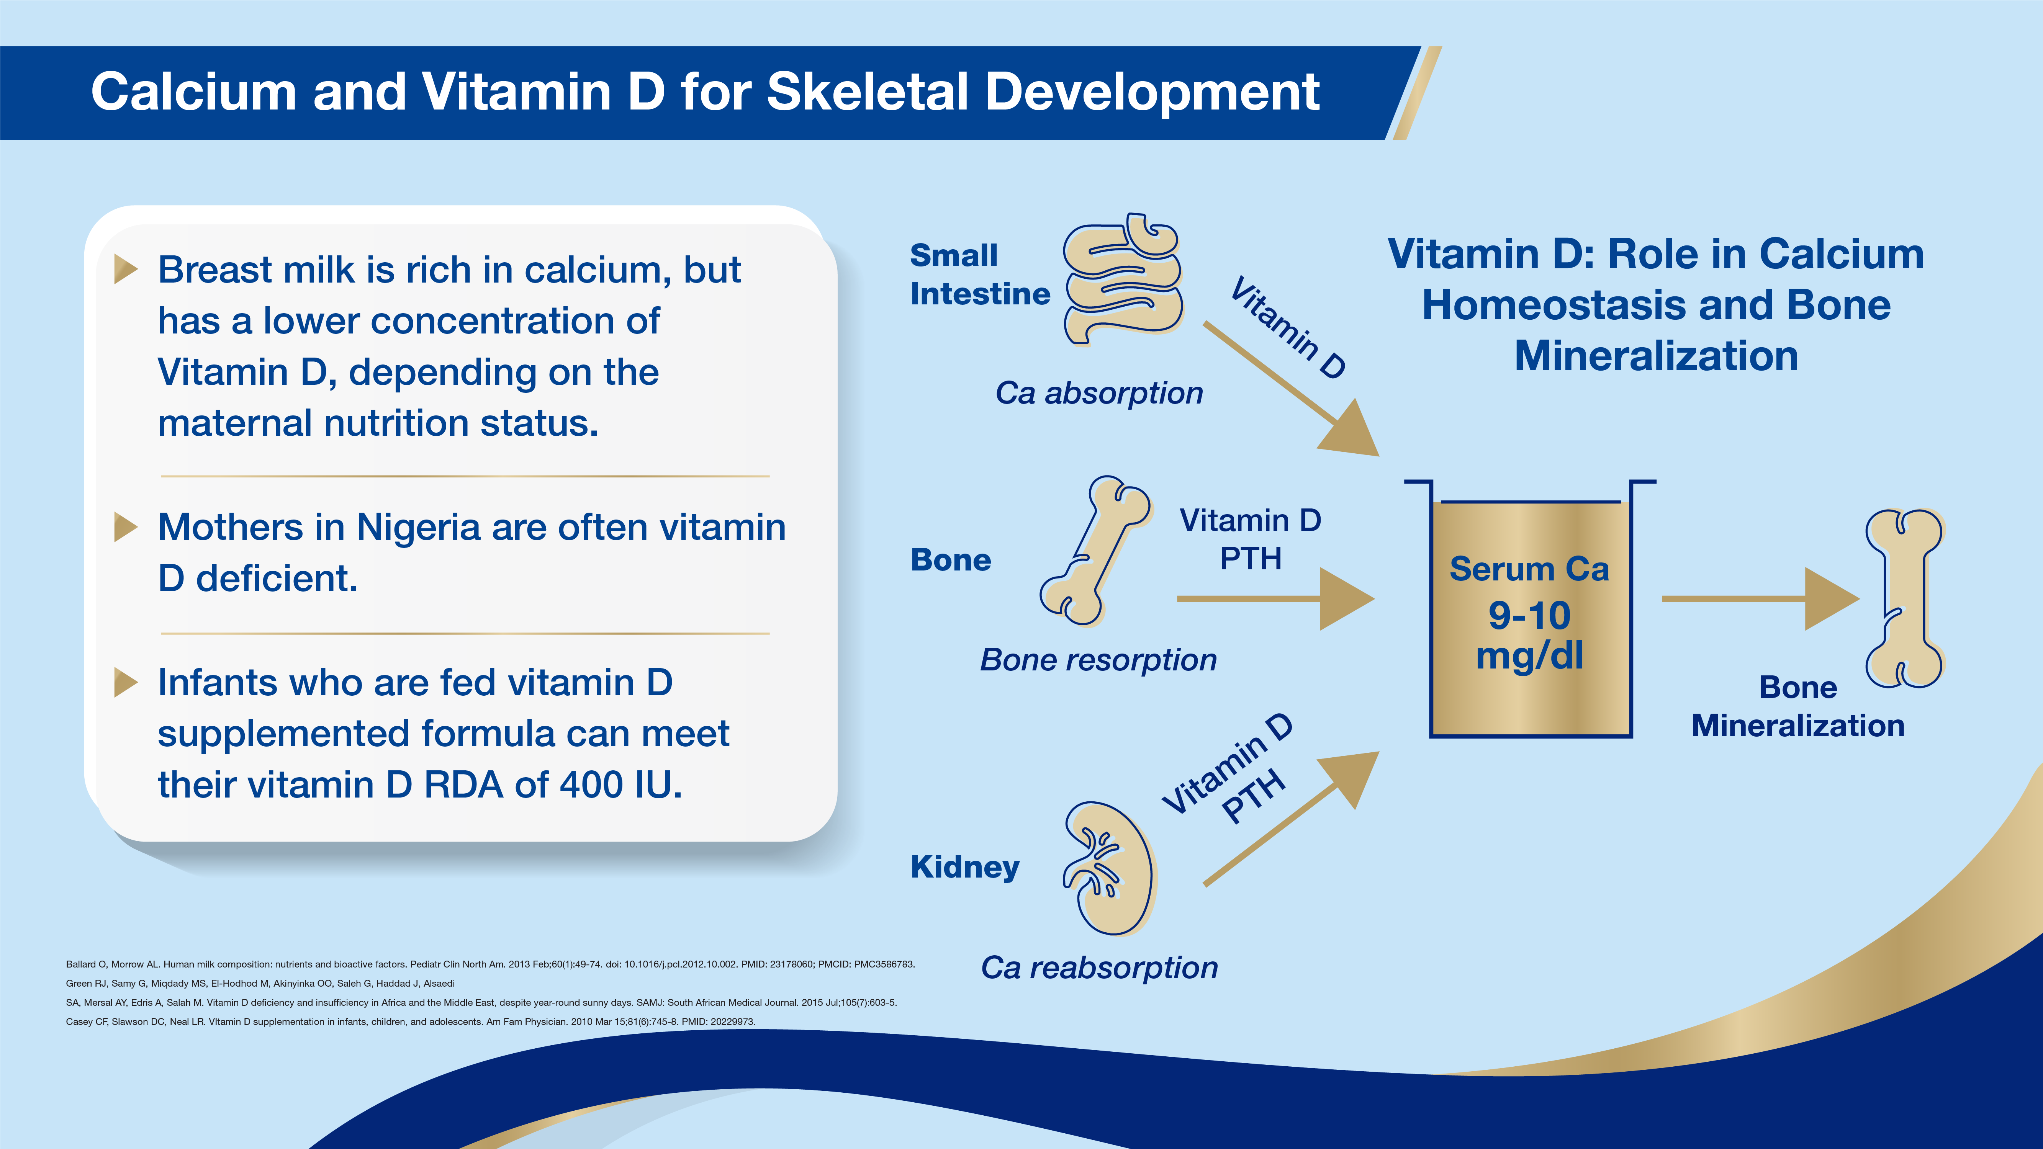
Notes:
Key Points
Calcium homeostasis is the mechanism by which the body maintains adequate calcium levels in order to prevent hypercalcemia or hypocalcemia, both of which can have important consequences for health.
Calcium homeostasis regulates calcium flow to and from the bones.
Inadequate calcium levels can result in osteoporosis.
Calcium release from bone is regulated by parathyroid hormone.
Vitamin D is converted to calcidiol (also called calcifediol)in the liver, which is then converted to calcitriol in the kidneys, the biologically active form of vitamin D.
Calcitriol regulates the levels of calcium and phosphorus in the blood and helps maintain a healthy skeletal system.
Bone resorption by osteoclasts releases calcium into the bloodstream, which helps regulate calcium homeostasis.
.

Slide 20
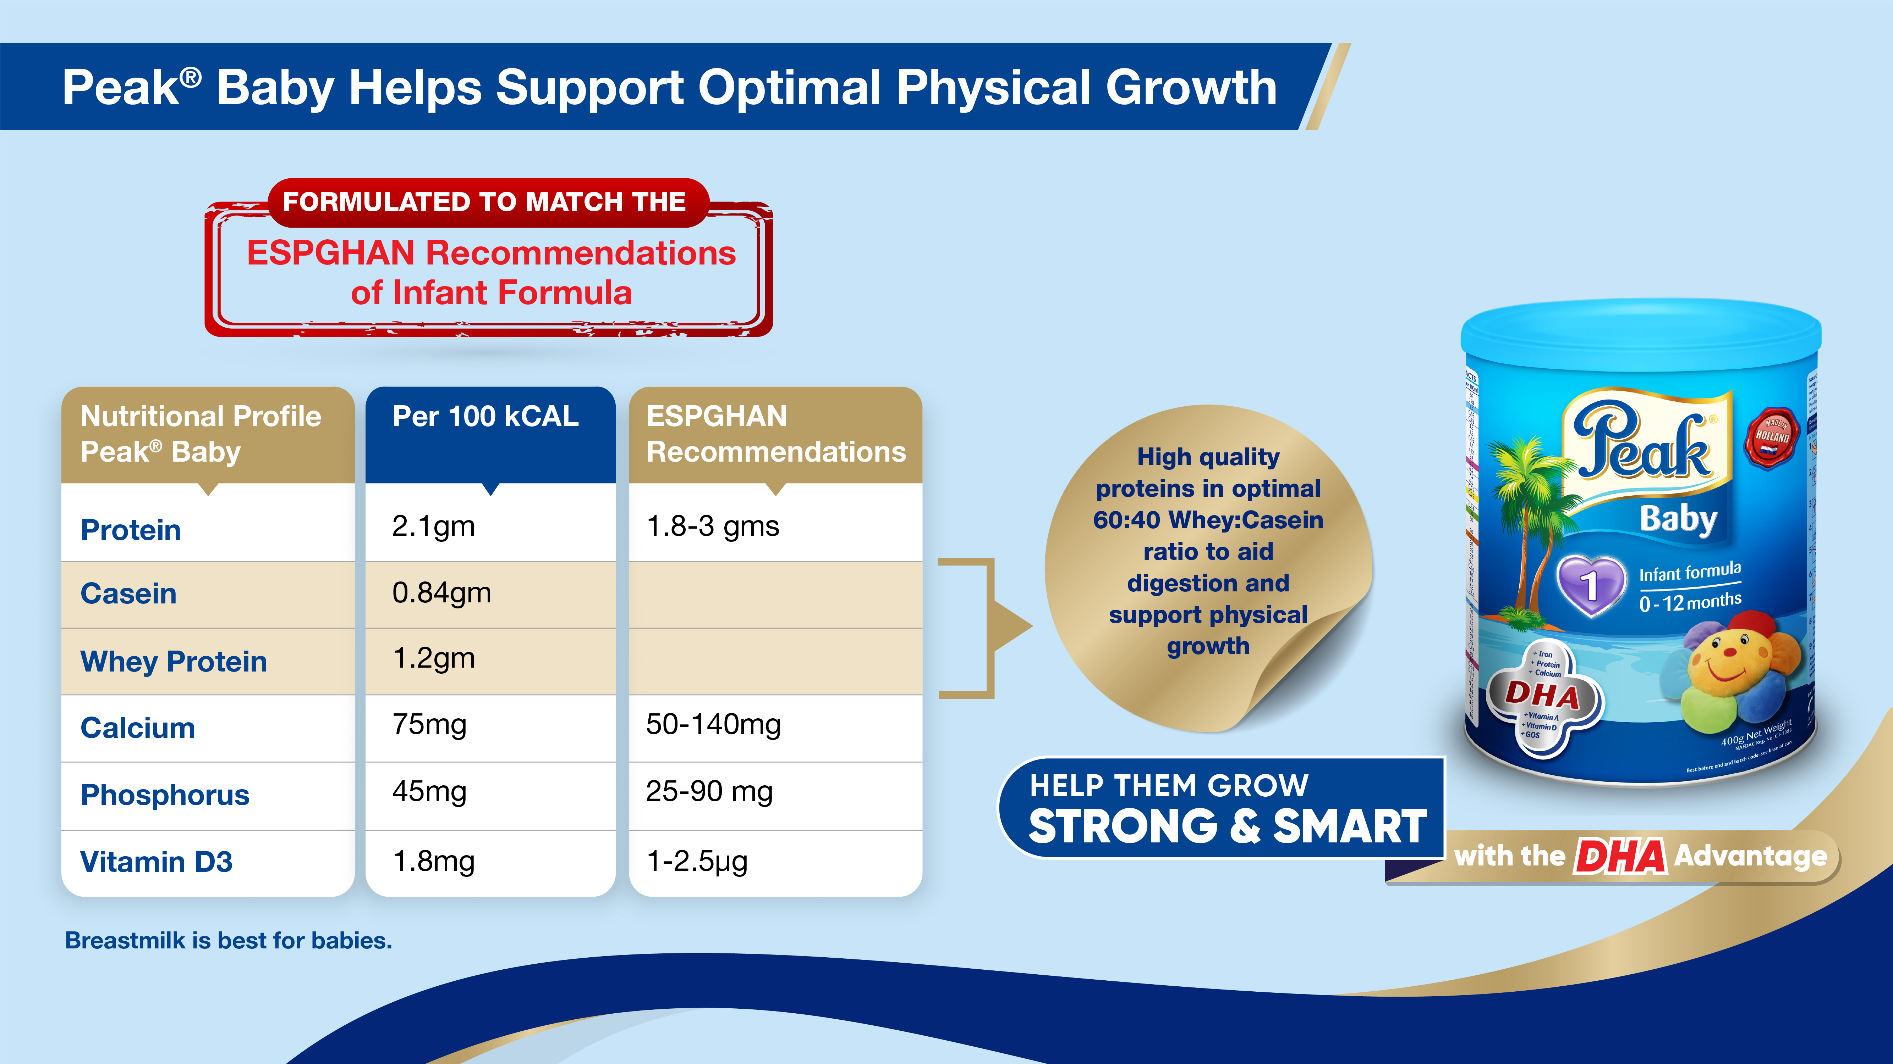


Slide 21
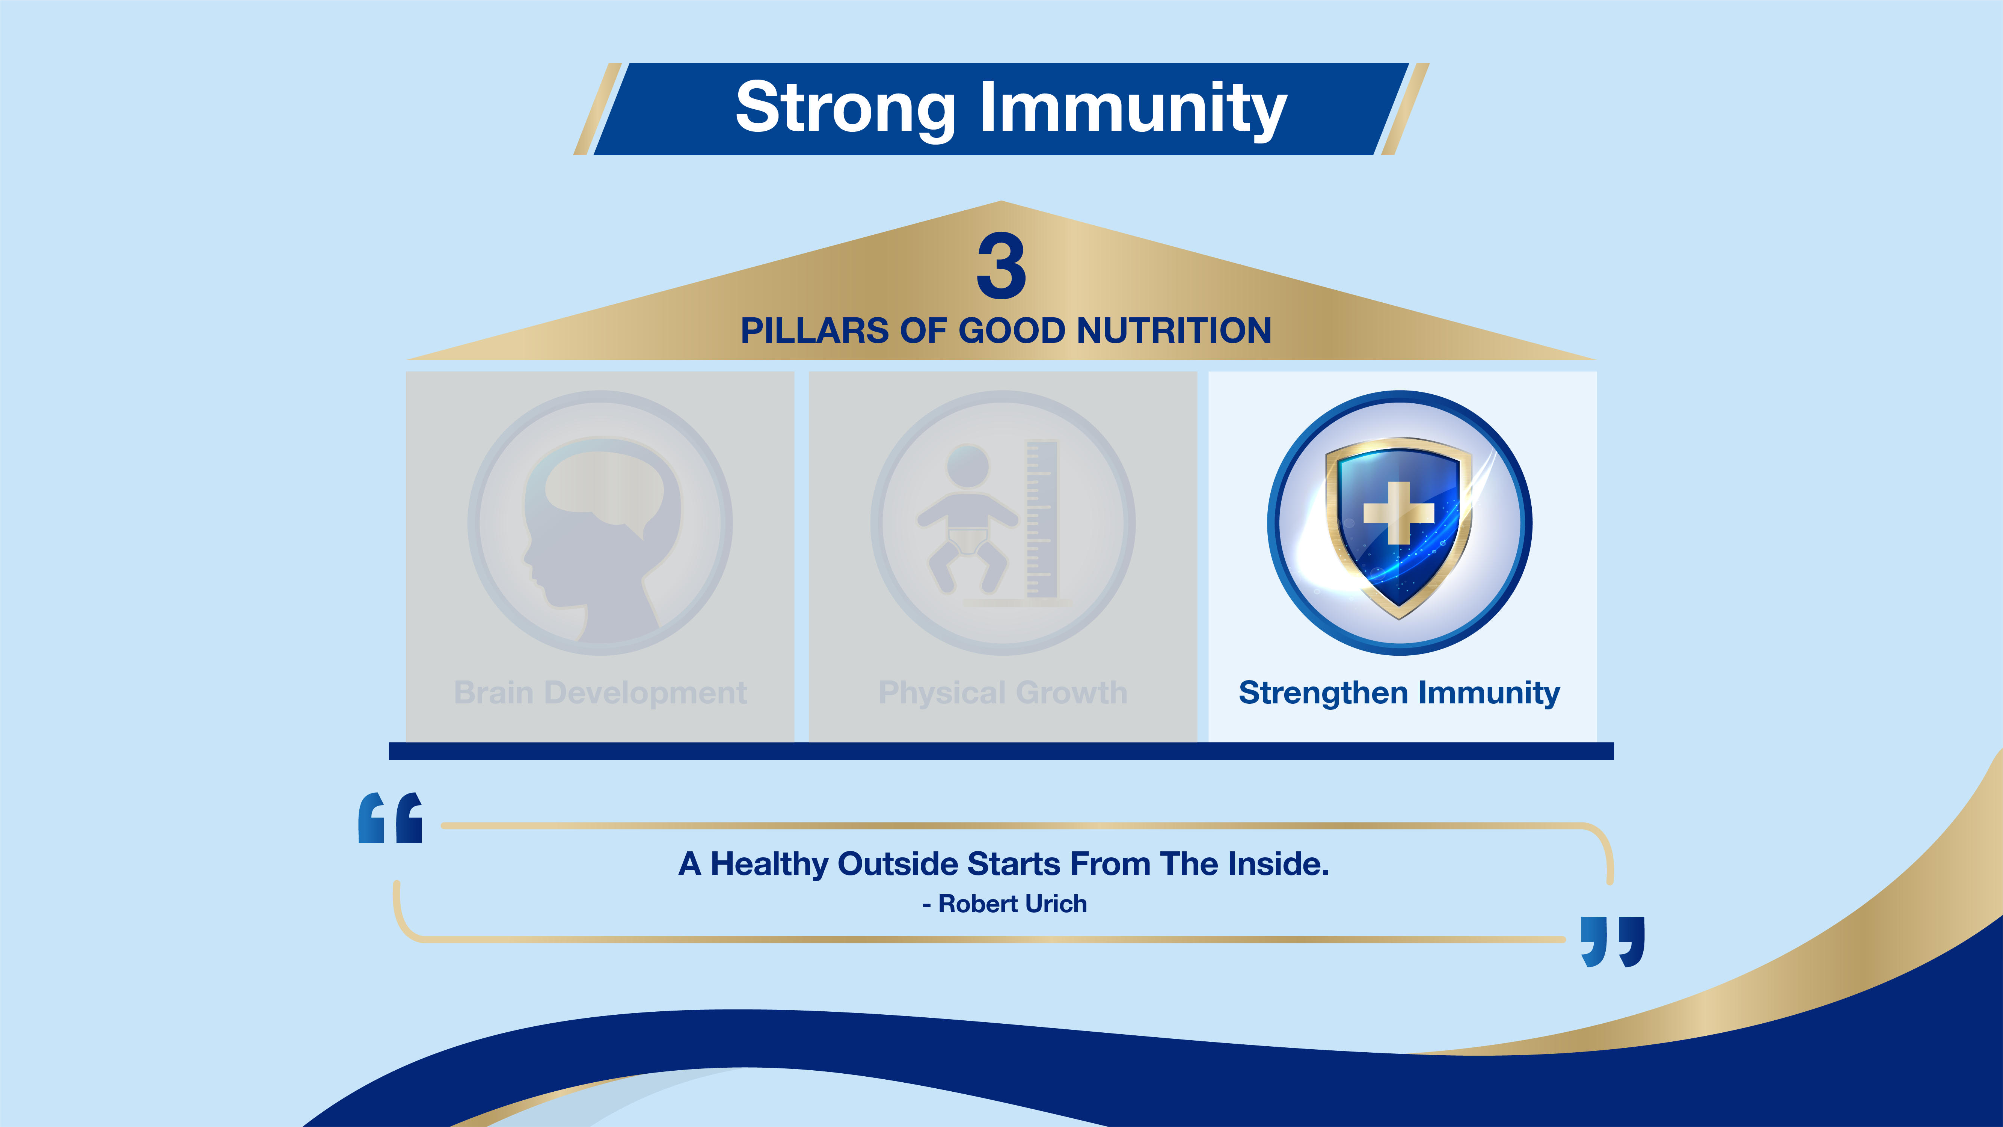

Slide 22
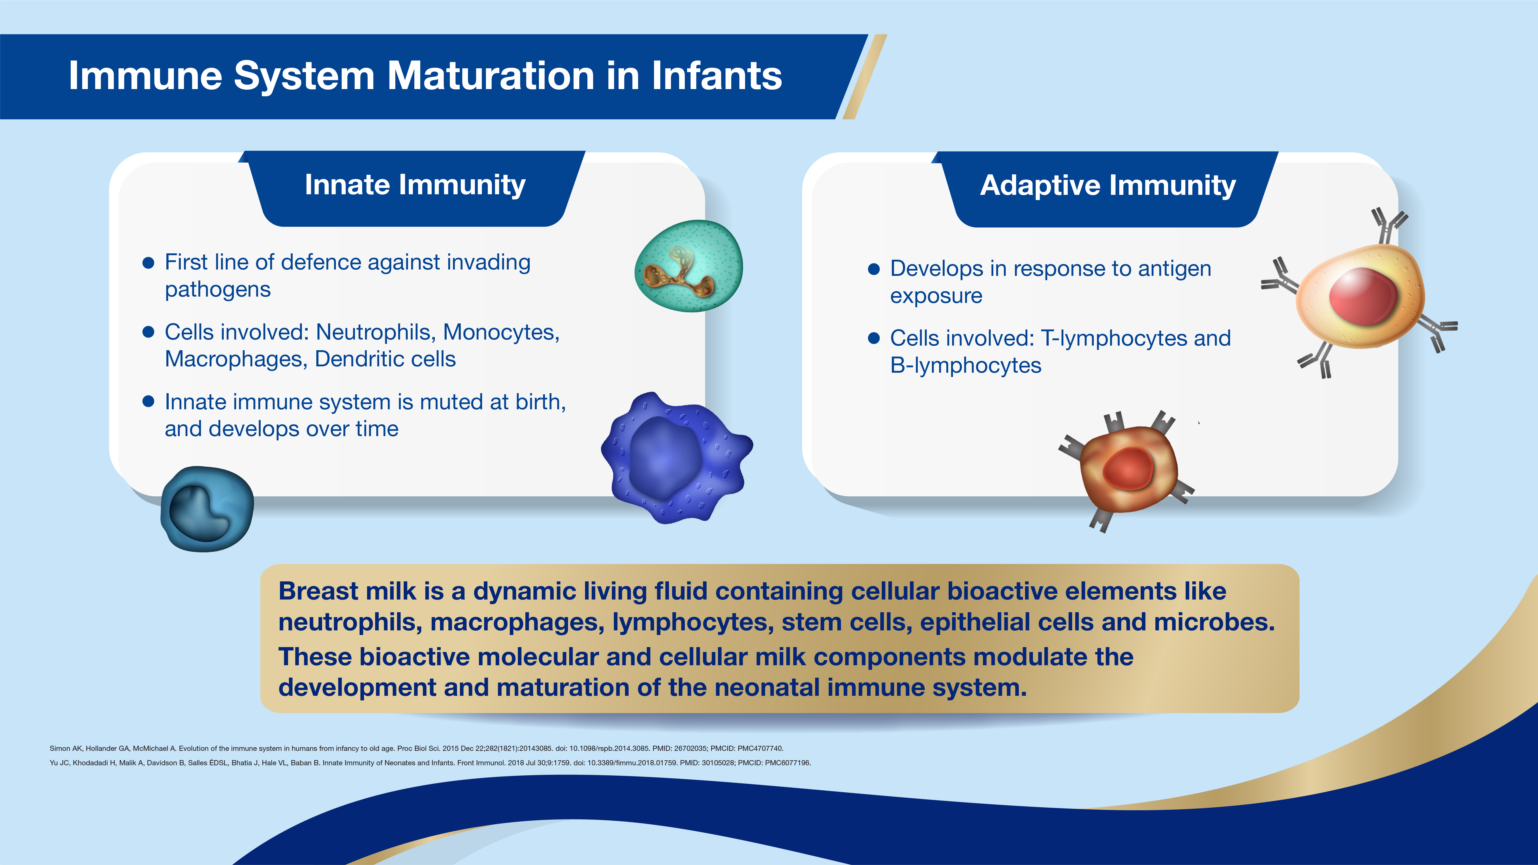
Notes:
Innate immunity, also known as genetic or natural immunity, is immunity that one is born with. This type of immunity is written in one's genes, offering lifelong protection. The innate immune response is fast acting and non-specific, meaning it does not respond differently based on the specific virus or bacteria that it detects. Adaptive immunity is created in response to exposure to a foreign substance. ... Once activated against a specific type of antigen, the immunity remains throughout the life. From birth, the infant immune system is immature. During the early years of life, the immune system needs the best possible support. Early life nutrition is essential in the development of a resilient immune system. Breastmilk which is the golden standard contains distinct bioactive molecules critical for infant development to protect the infant against infections and inflammations, contribute to immubne maturation, contribute to organ development and also contribute to healthy microbial colonization.

Slide 23
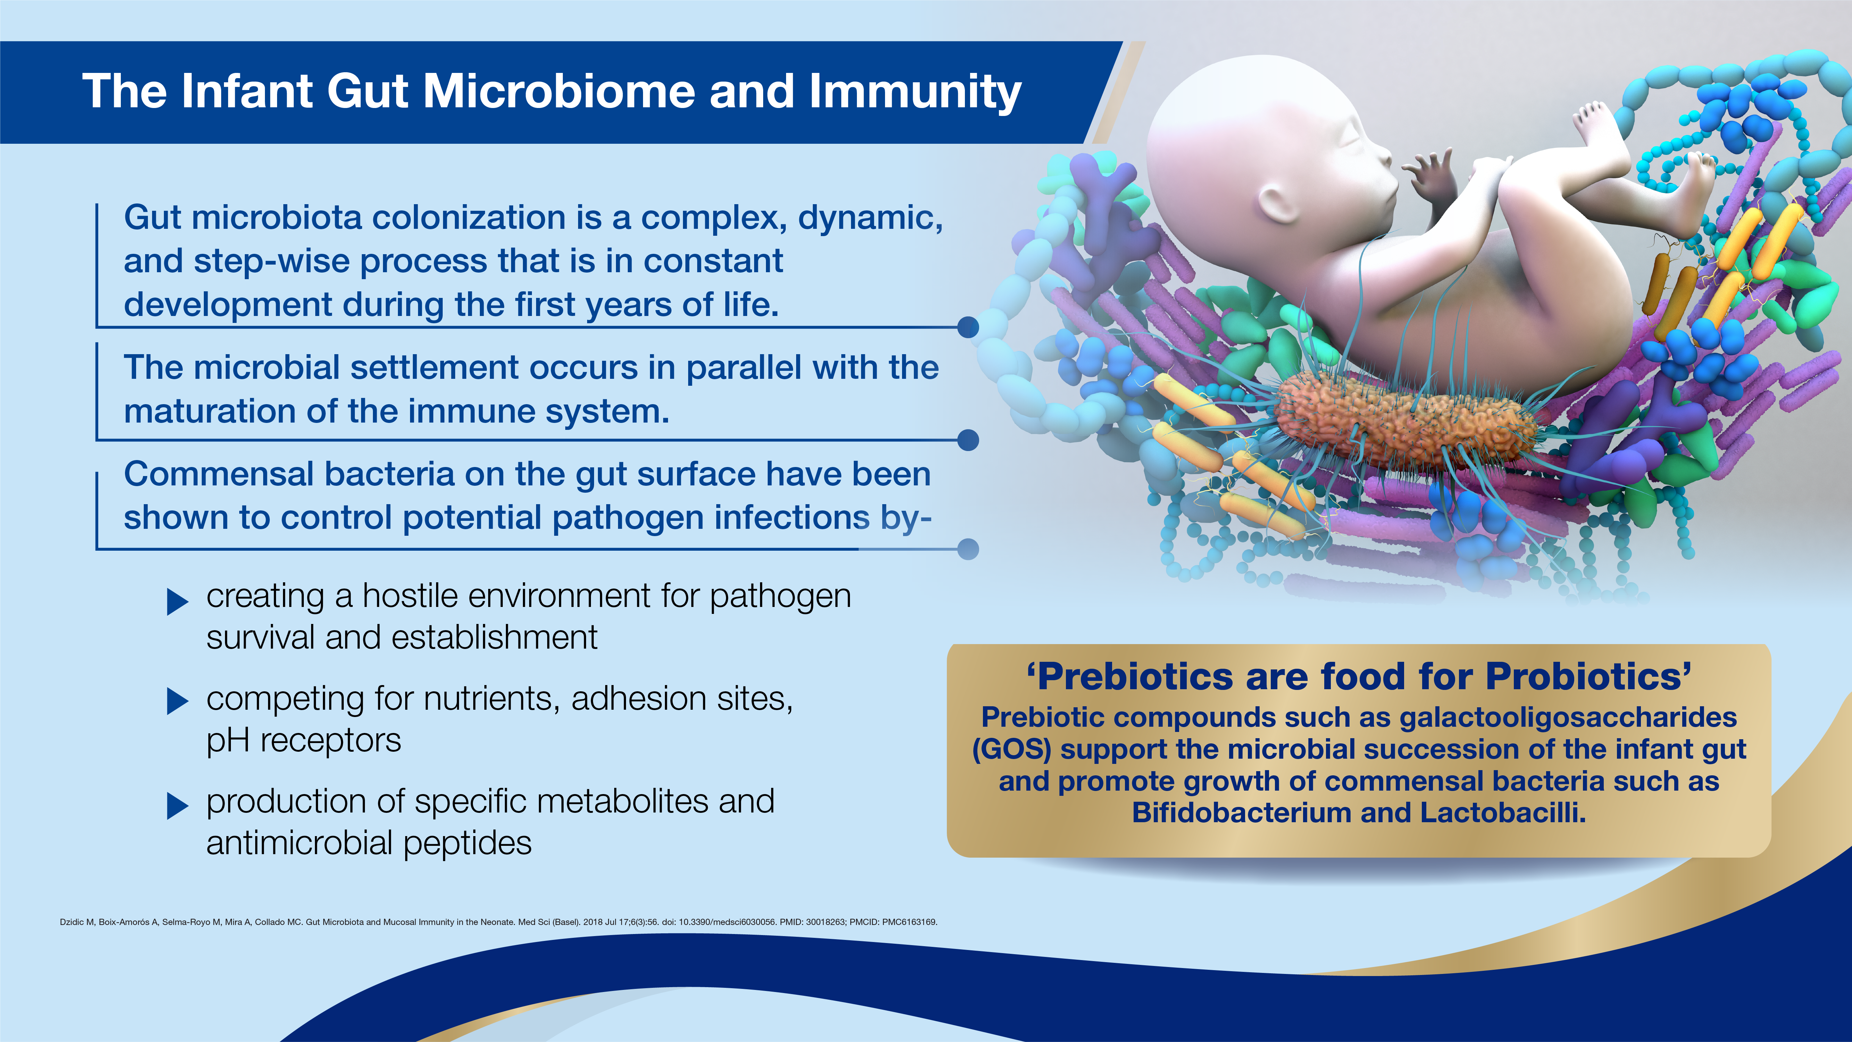
Notes:
Building stronger immunity starts in the gut. The GI tract plays a central role in immune system homeostasis. Nearly 70% of the entire immune system resides in the gut. A healthier gut reduces the risk of developing allergies and diseases such as diarrhea. According to the CDC, Diarrhoea kills over 2000 children under 5 years of age everyday, more than AIDS, malaria and measles combined.
Prebiotics serve as immune modulators to prime the immune system against allergic reactions and disease. They also modulate the epithelial barrier function to reduce inflammation. Serve as antiadhesive antimicrobials to prevent pathogen colonization.
Commensal bacteria- in GUT microbiome are microorganism (bacteria) that lives in the GUT and act on the host's immune system to induce protective responses that prevent colonization and invasion by pathogens.

Slide 24
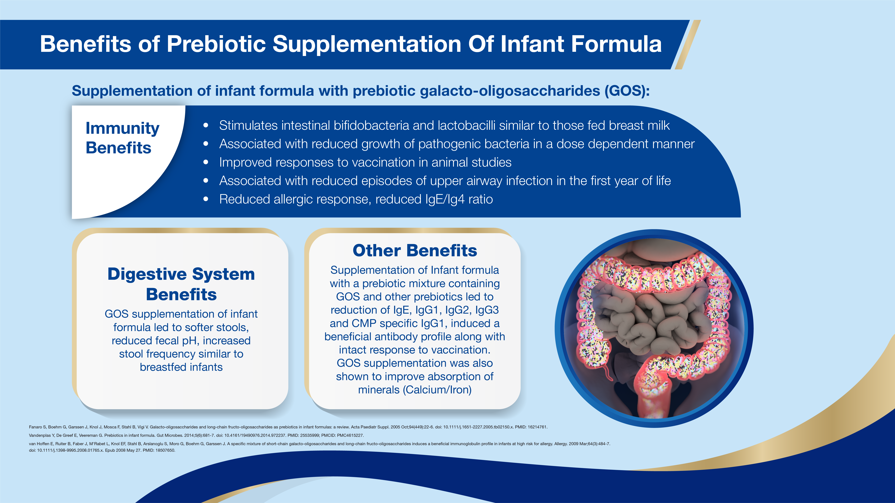
Notes:
The benefits of prebiotic supplementation of infant formula are vast including inducing a beneficial antibody profile along with an intact response to vaccination.

Slide 25
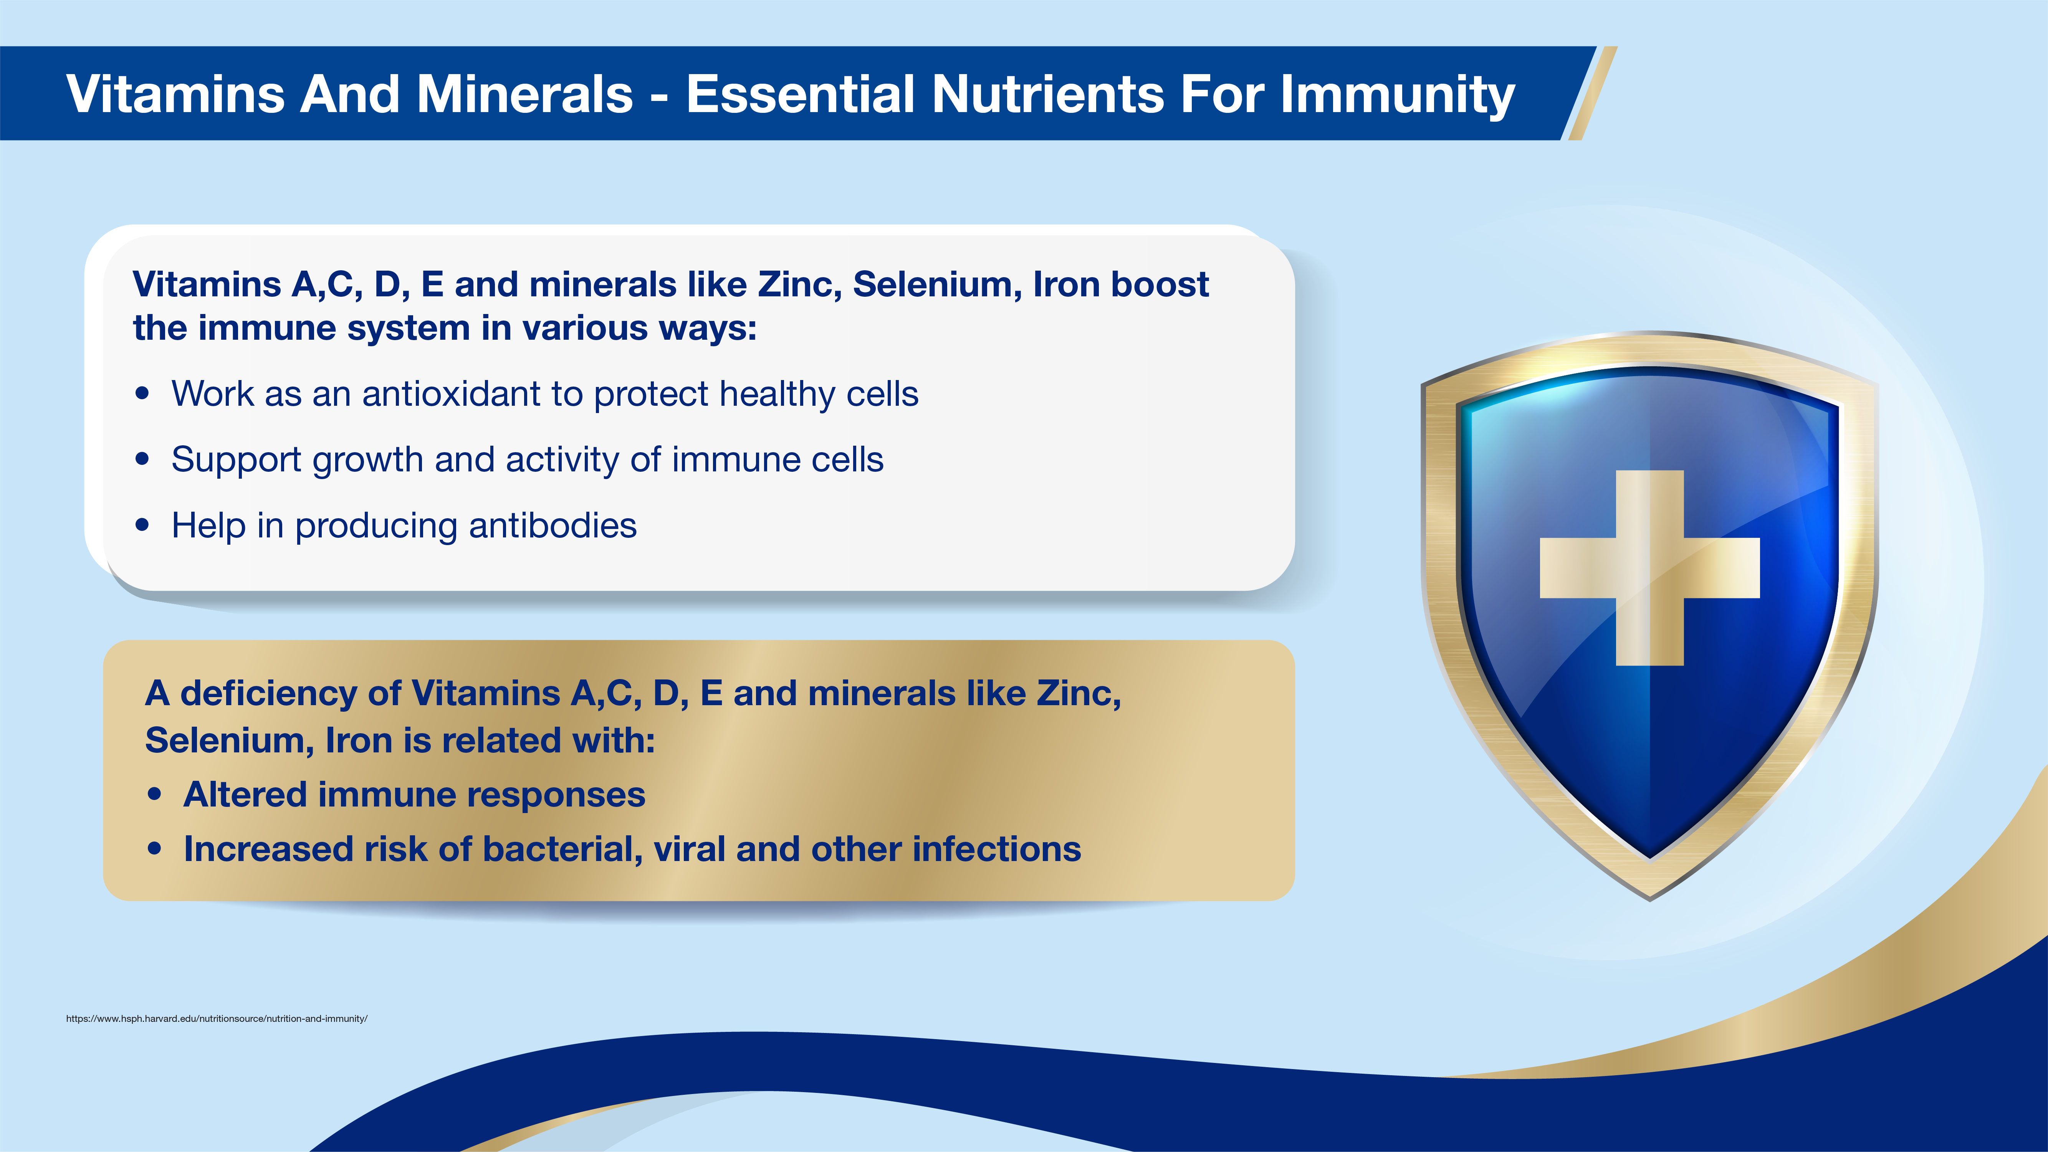
Notes:
Several other vitamins and minerals also play a pivotal role in immune system modulation

Slide 26
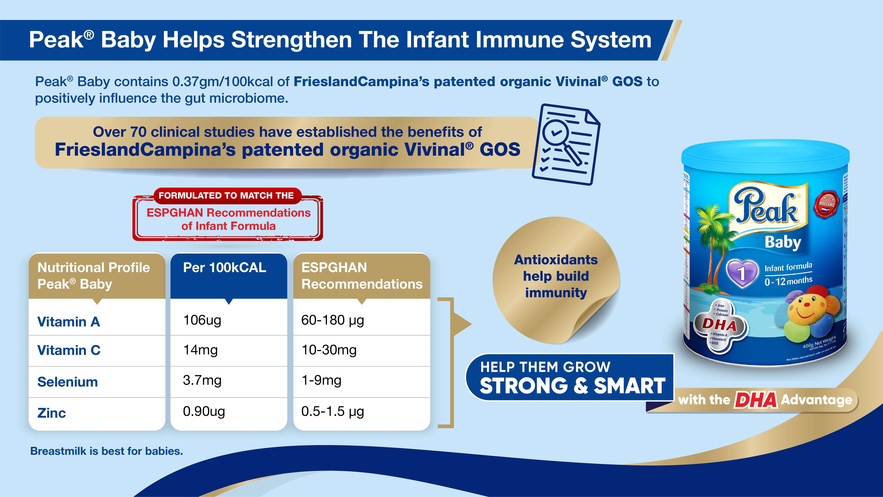
Notes:
Peak Baby is fortified with a patented Vivinal GOS with over 70 clinical studies establishing its efficacy

Slide 27
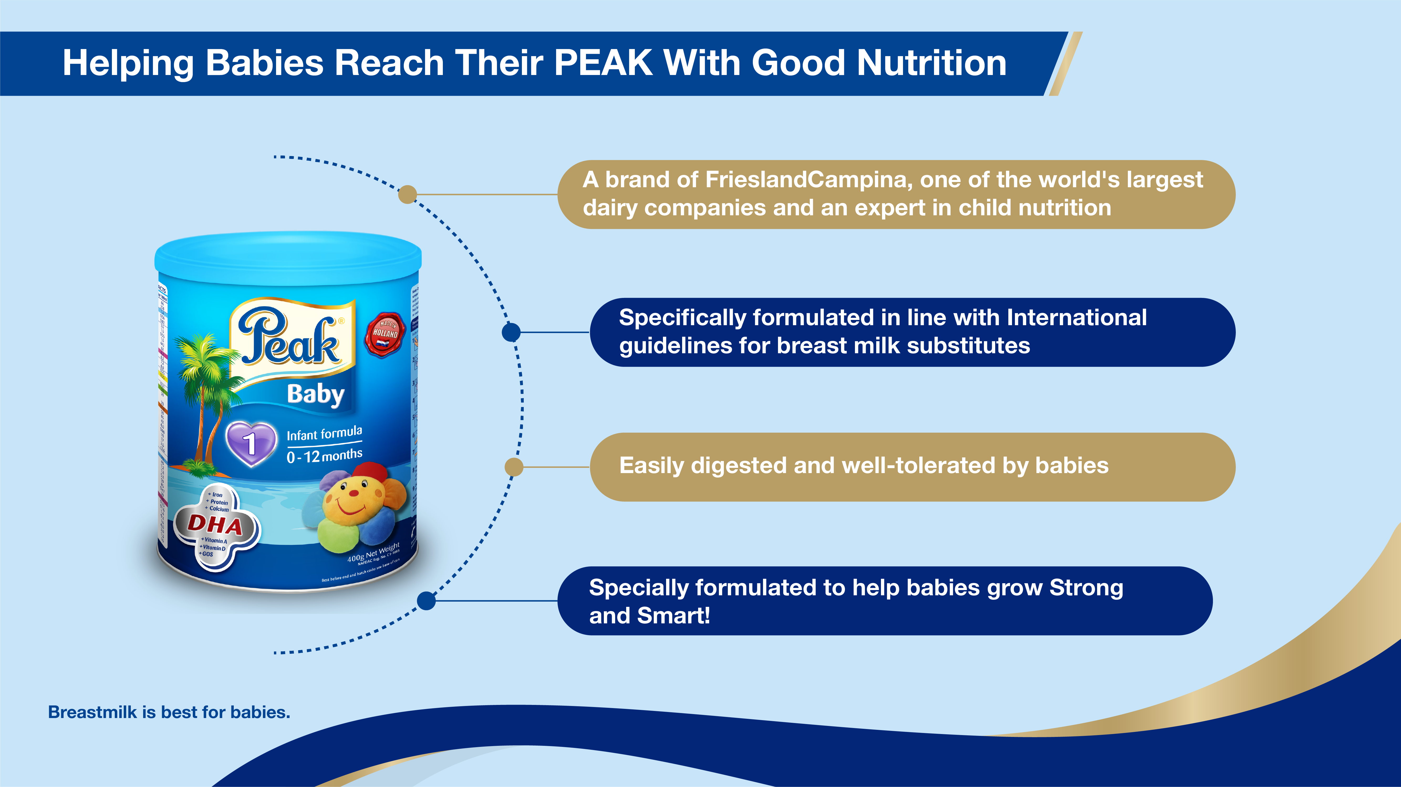
Notes:
All the above points like “expert in child nutrition”, easily digested and well-tolerated by babies are other HCP’s stated reco drivers that you should emphasize for Peak Baby to drive conversions

Slide 28
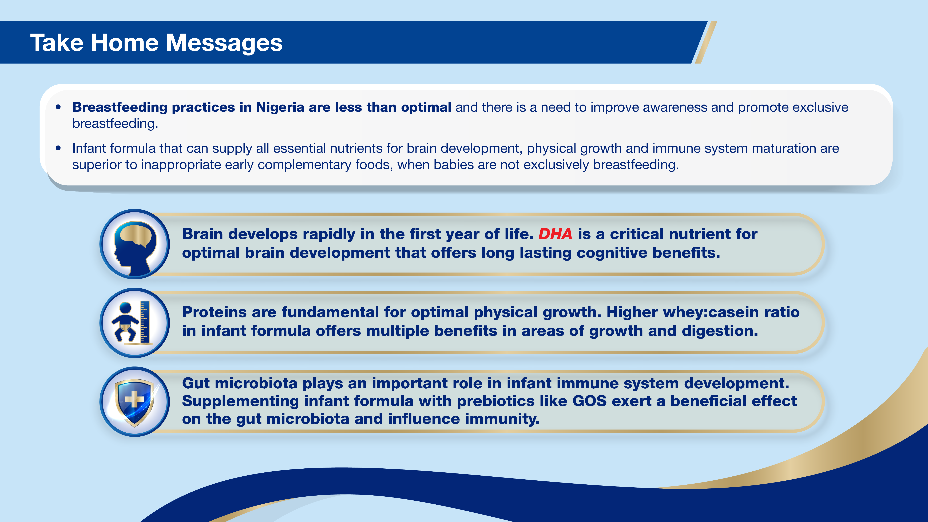

Slide 29
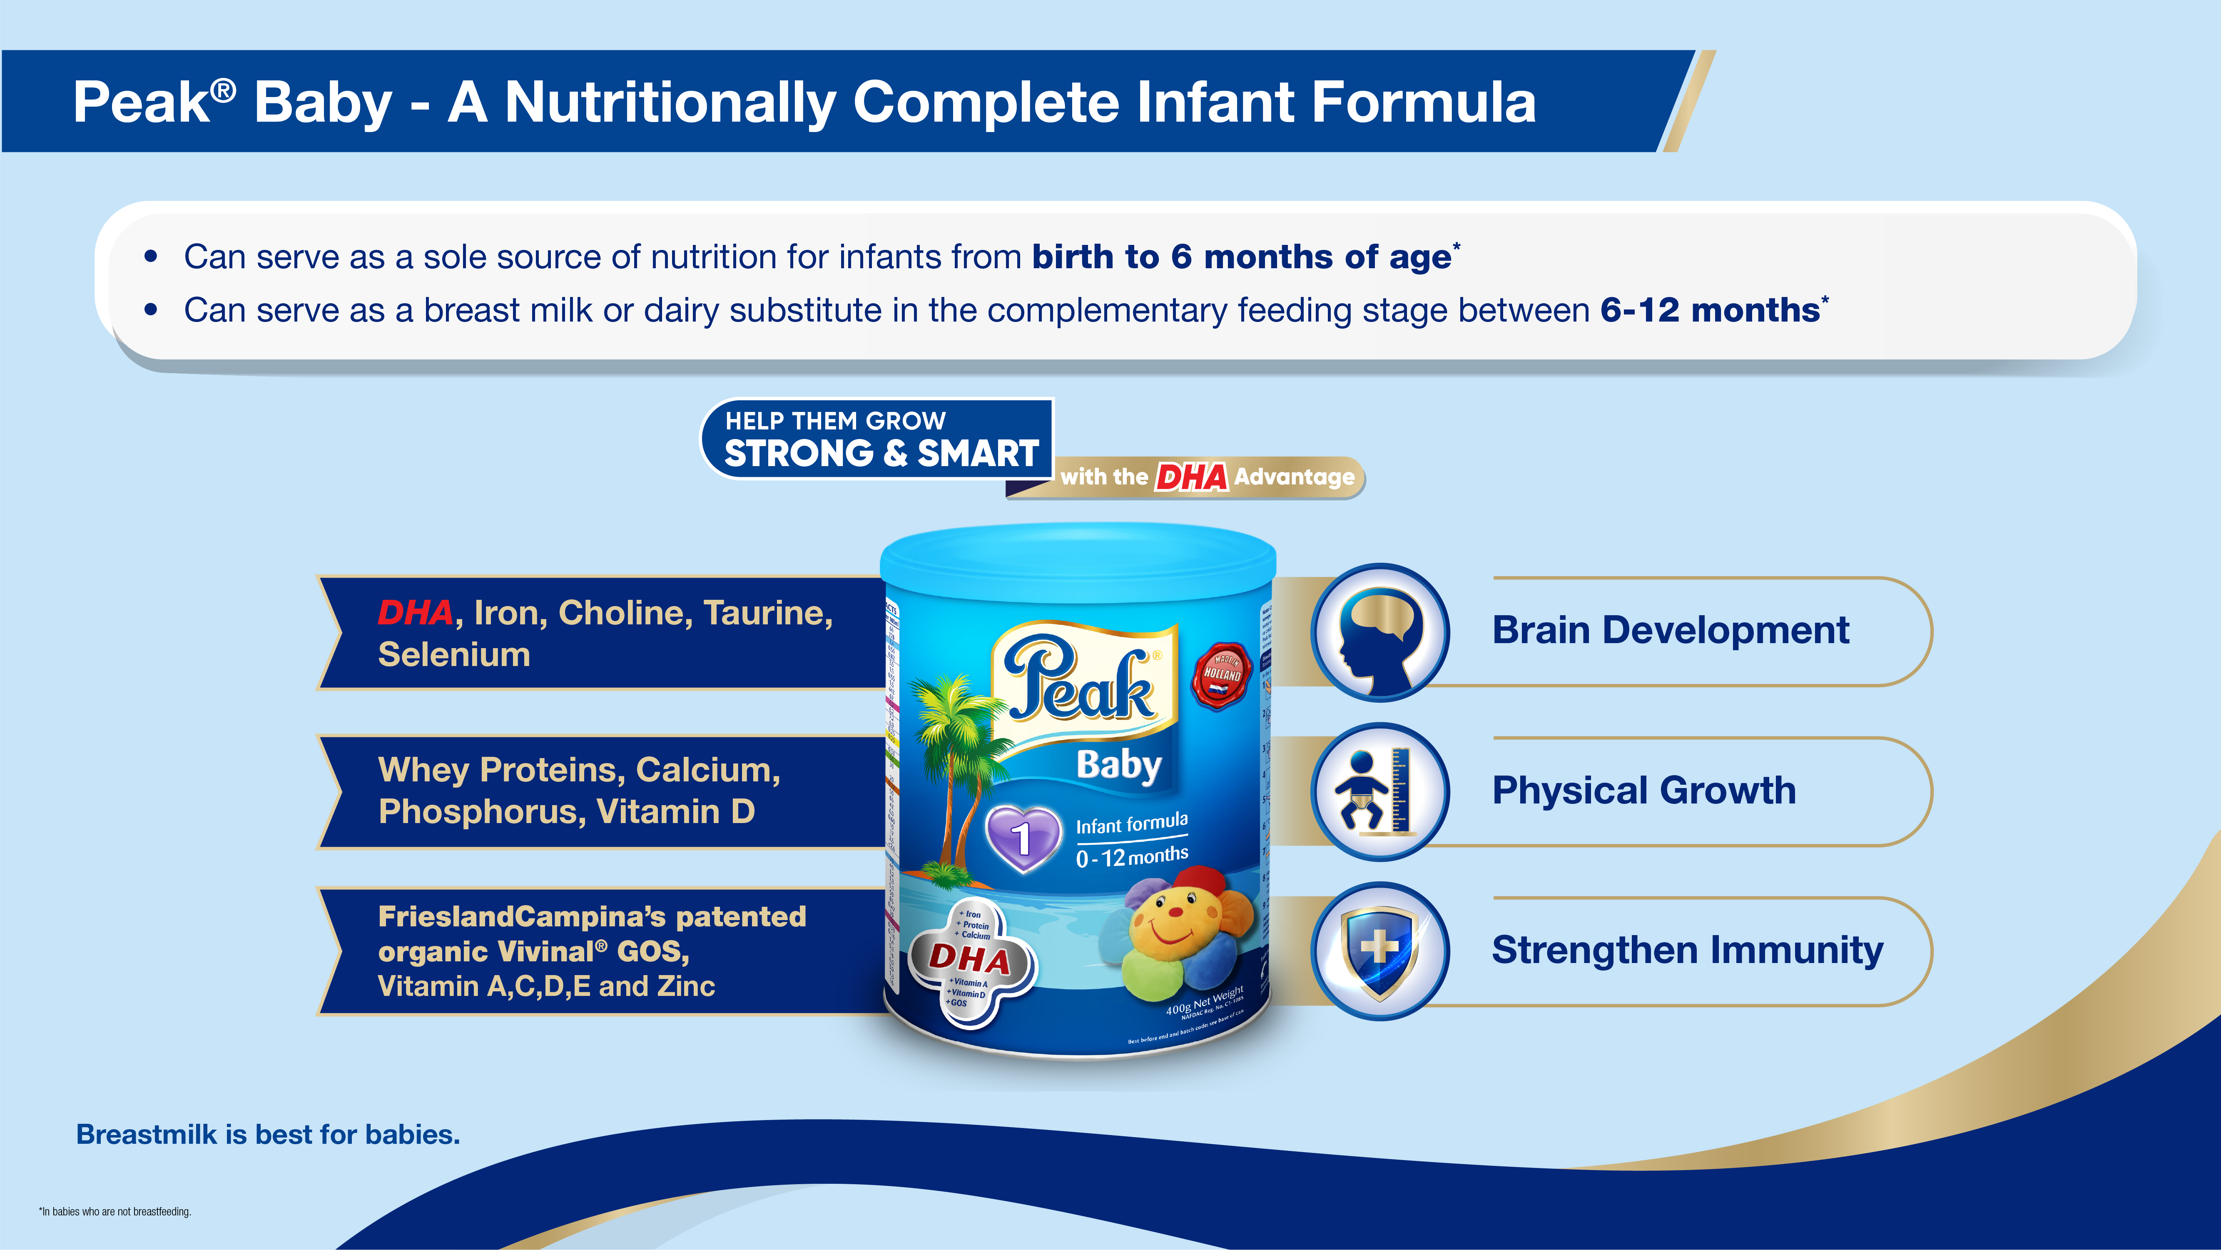

Notes:
This slide should already help to address the 0-12 concerns with the first 2 statements. They are in line with WHO recommendations

Slide 30
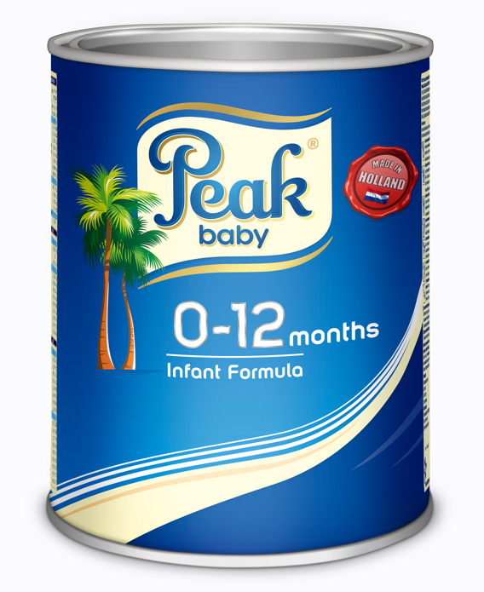
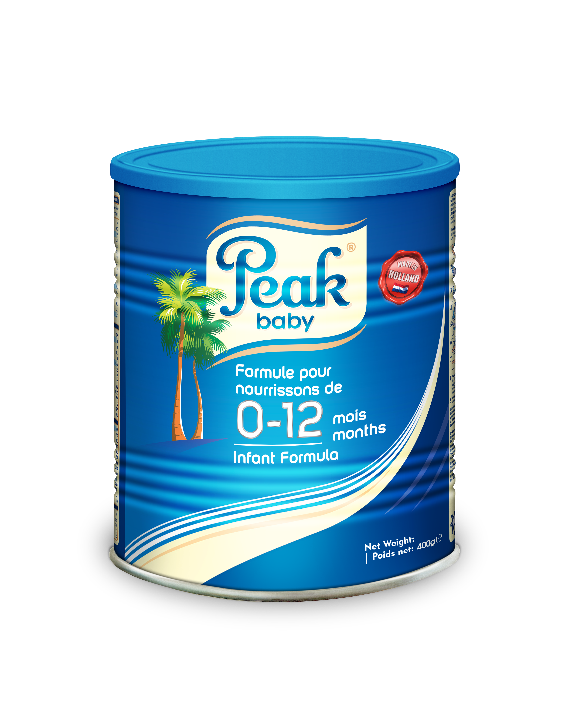



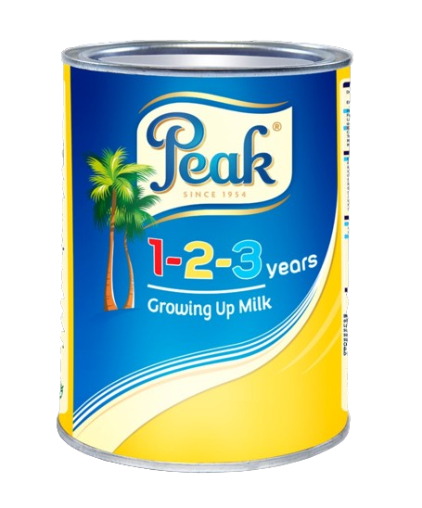
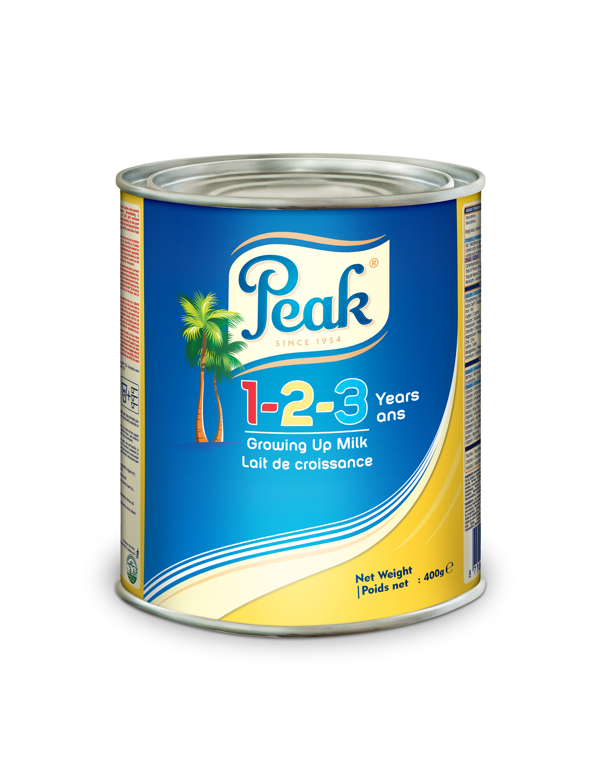

New look, Same great formulation!
Same trusted quality
Easily digested and well-tolerated by babies
Fortified with DHA and other brain-supportive nutrients
What’s different?
Packaging change in line with new regulatory guidelines for French speaking countries.
Inclusion of French translation on the pack
No change in formulation!

Slide 31
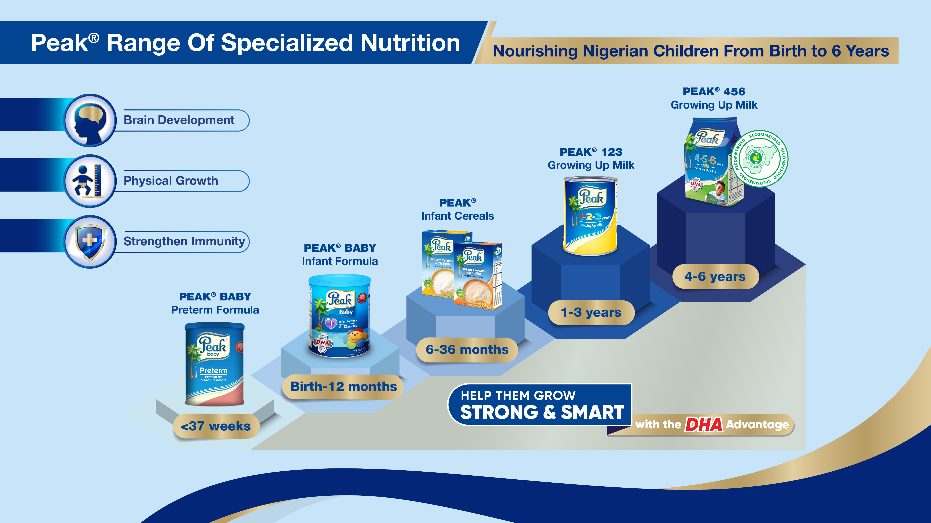
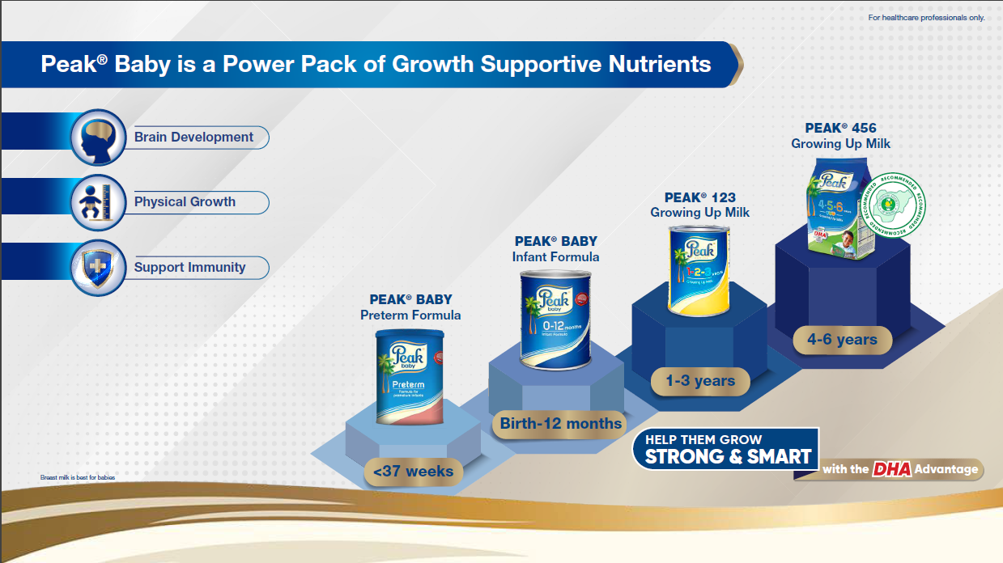
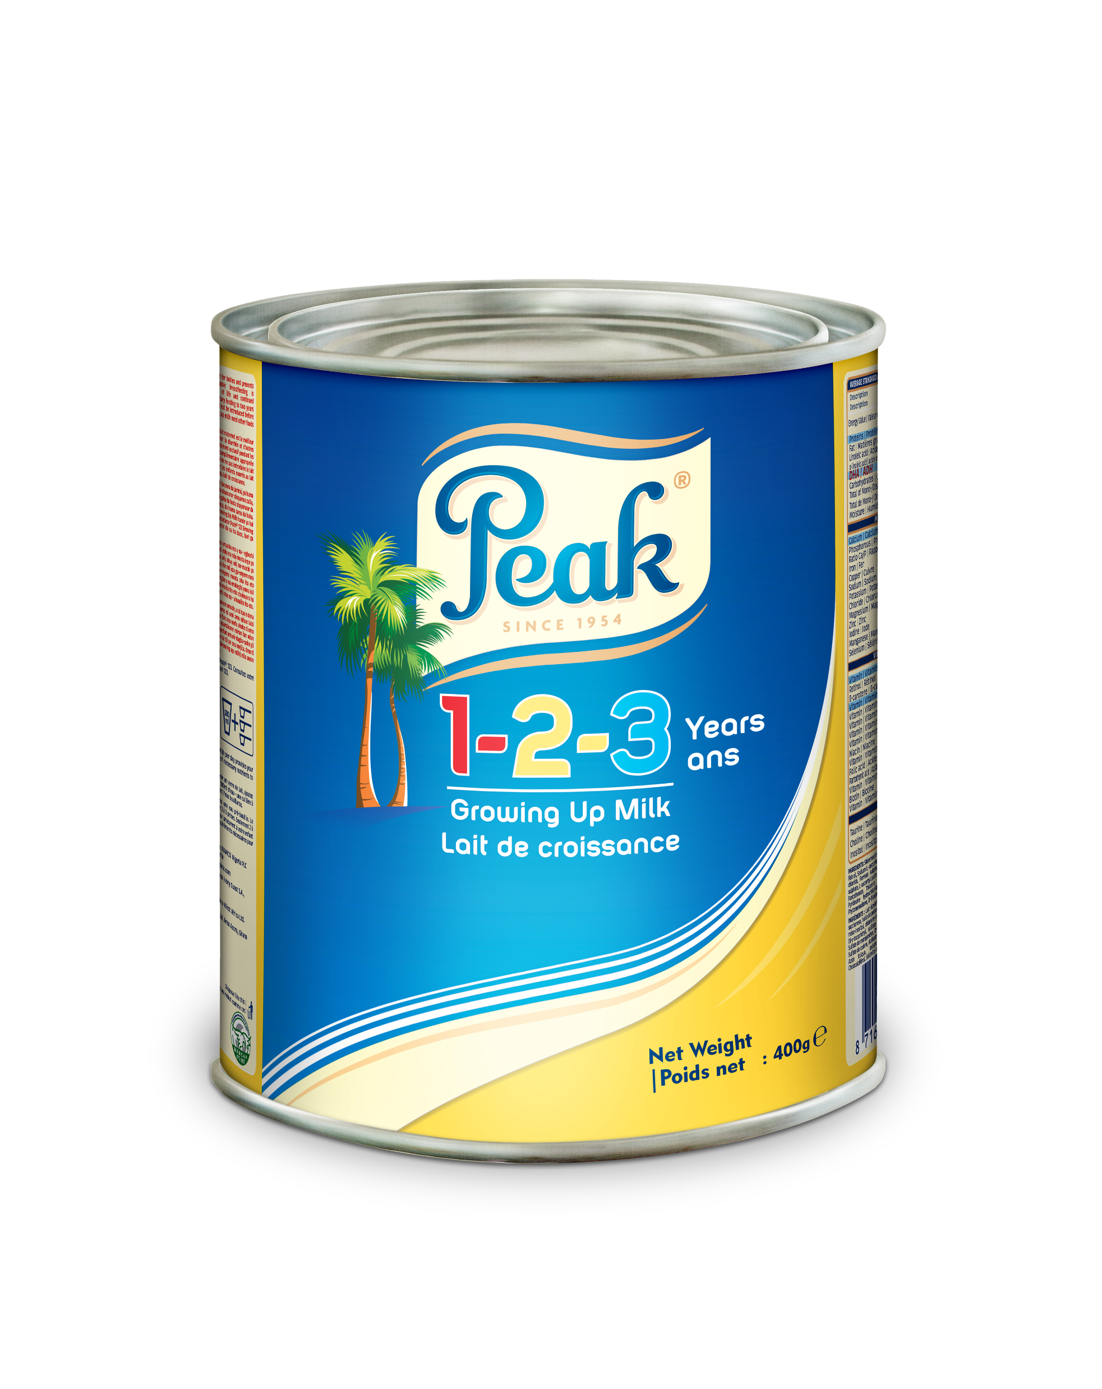

Notes:
There you have your bragging rights☺
The Peak brand from the stables of FrieslandCampina is the only brand that completely caters for the first 6 years of life where nutrition is particularly critical.
CTA: Help them grow strong and smart with the DHA advantage
Keep winning guys☺ Looking forward to hearing your ACE stories☺

Slide 32


Slide 33
